Slide 1
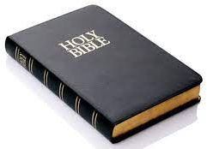
Ten Shocking Bible Truths Sabbatarians Have Never Heard
Steven Rudd, 2023
www.bible.ca/sabbath.htm

Slide 2
Shocking Truth #10
“All Sabbatarians agree the first covenant was
abolished when it was nailed to the cross.”
“When God said, “A new covenant,”
He has made the first obsolete.”
(Hebrews 8:13)
“He has taken it out of the way,
having nailed it to the cross.”
(Colossian 2:14)

Slide 3
Shocking Truth #10
I agree
“All Sabbatarians agree the first covenant was
abolished when it was nailed to the cross.”
“When God said, “A new covenant,”
He has made the first obsolete.”
(Hebrews 8:13)
“He has taken it out of the way,
having nailed it to the cross.”
(Colossian 2:14)

Slide 4
Shocking Truth #10
The 10 Commandments were the legal
text of the abolished first covenant.
“All Sabbatarians agree the first covenant was
abolished when it was nailed to the cross.”
“When God said, “A new covenant,”
He has made the first obsolete.”
(Hebrews 8:13)
“He has taken it out of the way,
having nailed it to the cross.”
(Colossian 2:14)

Slide 5
Shocking Truth #10
The 10 Commandments were the legal
text of the abolished first covenant.
Heb 8:13f
“When God said, “A new covenant,” He has made the first obsolete. Now even the first covenant had regulations of divine worship. There was a tabernacle, the lampstand, the table of showbread, the altar of incense, the ark of the covenant, the jar of manna, Aaron’s rod and the tables of the covenant.”

Slide 6
Shocking Truth #10
The 10 Commandments were the legal
text of the abolished first covenant.
Hebrews 8:13-9:4: obsolete tabernacle
I agree
I agree

Slide 7
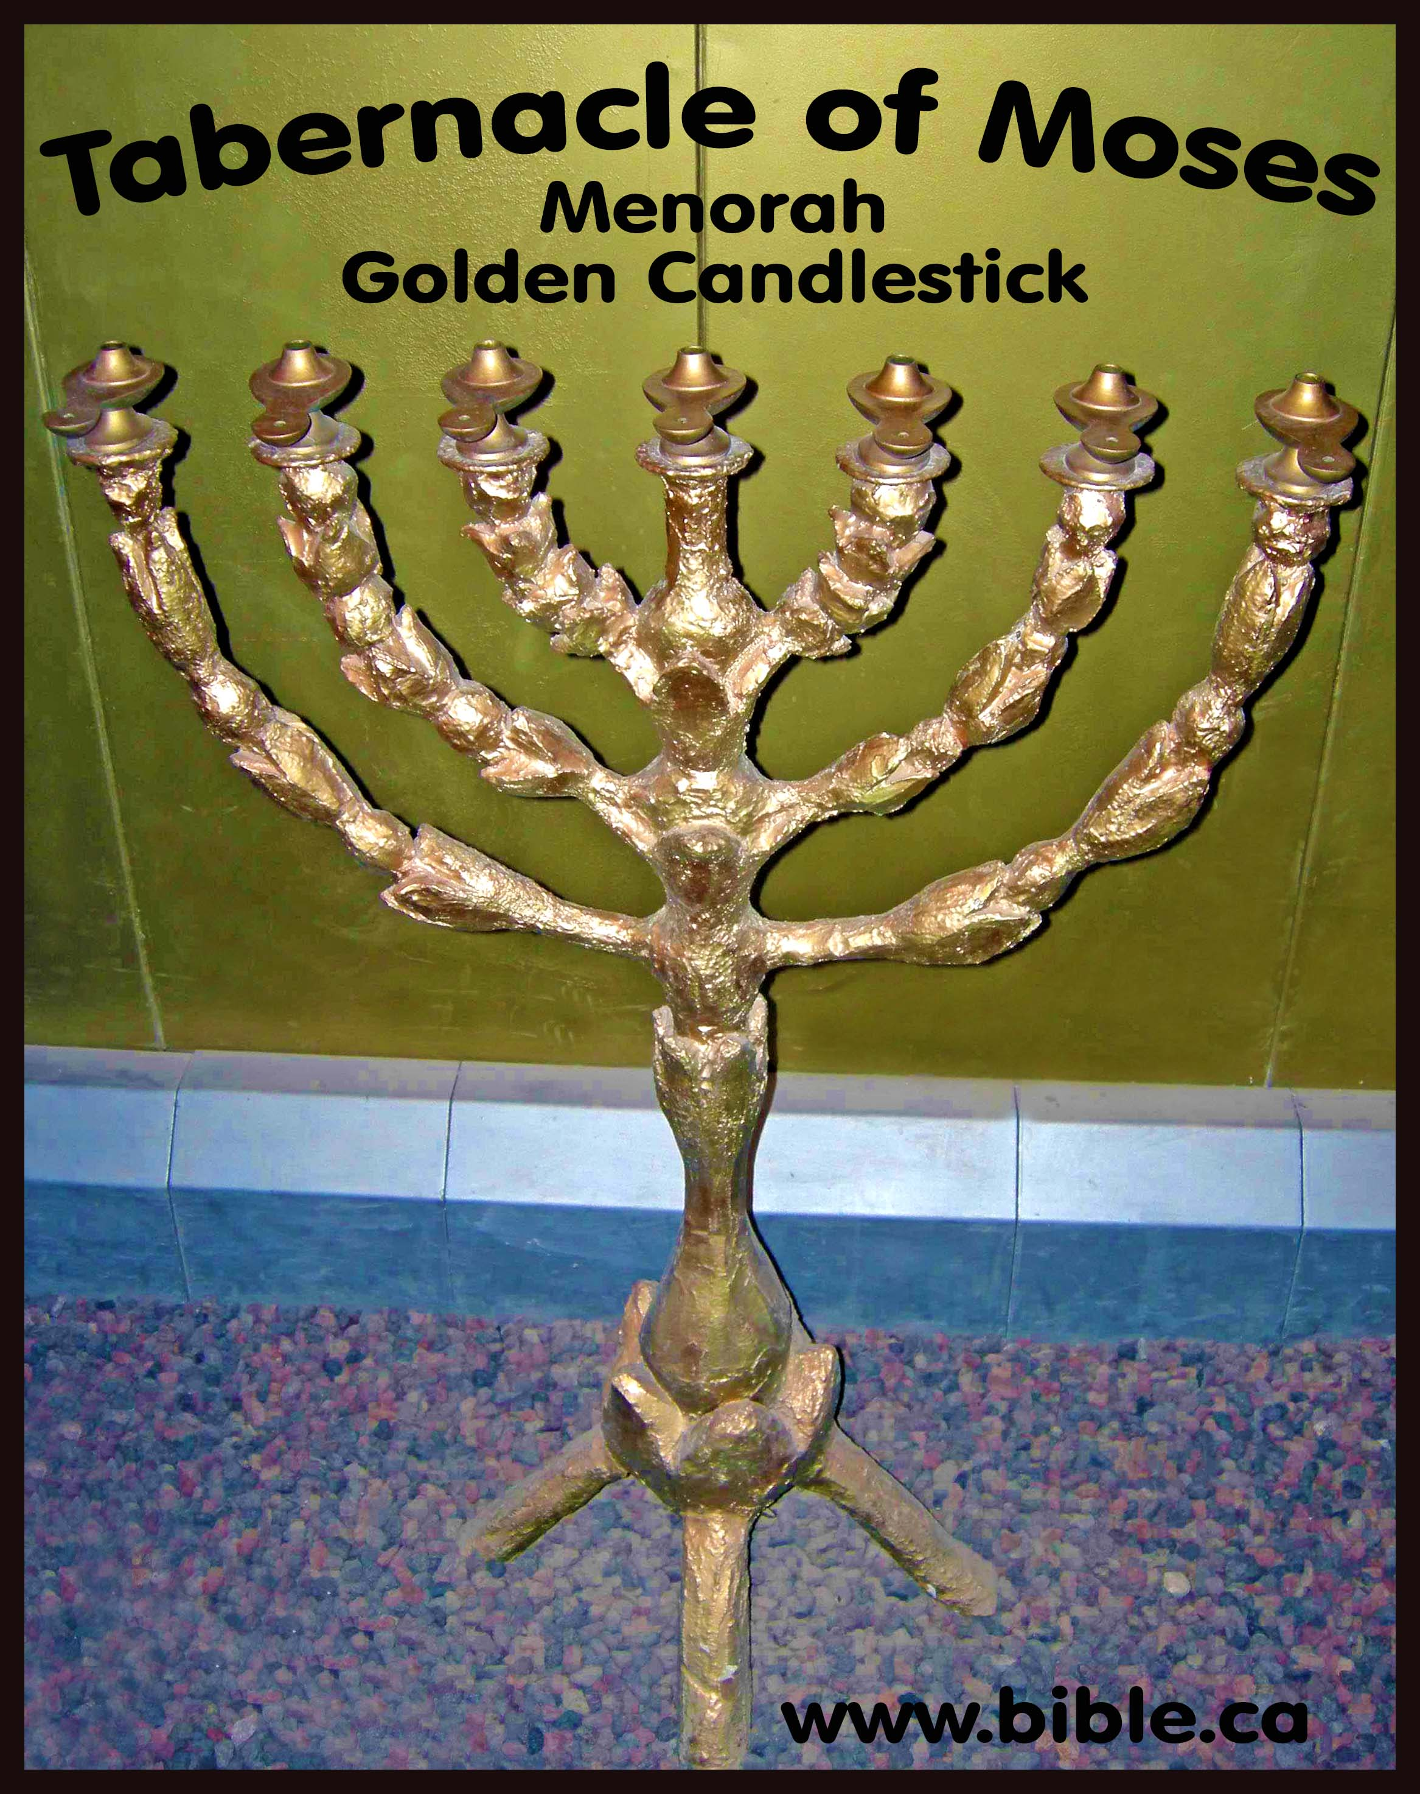
Shocking Truth #10
The 10 Commandments were the legal
text of the abolished first covenant.
Hebrews 8:13-9:4: obsolete lampstand
I agree

Slide 8
Shocking Truth #10
The 10 Commandments were the legal
text of the abolished first covenant.
Hebrews 8:13-9:4: obsolete table of showbread
I agree

Slide 9
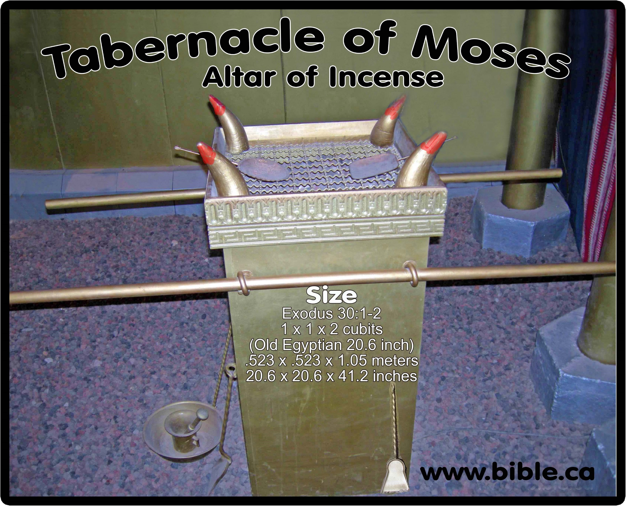
Shocking Truth #10
The 10 Commandments were the legal
text of the abolished first covenant.
Hebrews 8:13-9:4: obsolete altar of incense
I agree

Slide 10
Shocking Truth #10
The 10 Commandments were the legal
text of the abolished first covenant.
Hebrews 8:13-9:4: obsolete Ark of the Covenant
I agree

Slide 11
Shocking Truth #10
The 10 Commandments were the legal
text of the abolished first covenant.
Hebrews 8:13-9:4: obsolete Ten Commandments

Slide 12
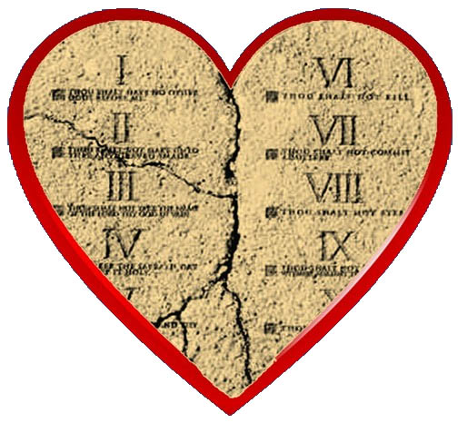
Shocking Truth #10
The 10 Commandments were the legal
text of the abolished first covenant.
“Today the 10 commandments are
written on our hearts not stone!”

Slide 13
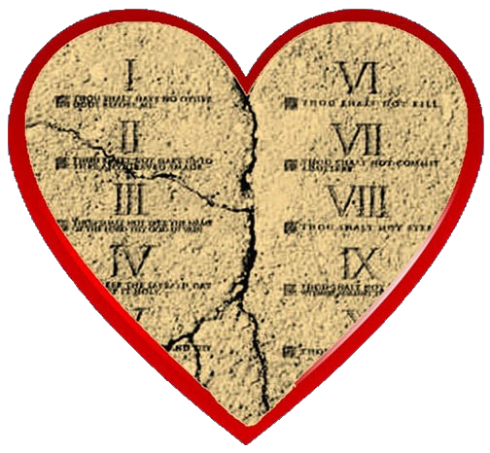
Shocking Truth #10
The 10 Commandments were the legal
text of the abolished first covenant.
Stone was not the covenant, the text on the stone was the covenant. God didn’t abolish the stone tablets, He abolished the text written on stone tablets. The covenant was the text not the stone.
God didn’t abolish stone, God abolished law.

Slide 14
Shocking Truth #10
The 10 Commandments were the legal
text of the abolished first covenant.
The First Covenant was written on stone.
The New Covenant was written on the heart.
Law of
Christ
Gal 6:2
Law of Moses
First Covenant
New Covenant

Slide 15
Shocking Truth #10
The 10 Commandments were the legal
text of the abolished first covenant.
“When God said, “A new covenant,” He has made the first obsolete. Now even the first covenant had regulations of divine worship. There was a tabernacle, the lampstand, the table of showbread, the altar of incense, the ark of the covenant, the jar of manna, Aaron’s rod and the tables of the covenant.”

Slide 16
Shocking Truth #10
The 10 Commandments were the legal
text of the abolished first covenant.
“When God said, “A new covenant,” He has made the first obsolete. Now even the first covenant had regulations of divine worship. There was a tabernacle, the lampstand, the table of showbread, the altar of incense, the ark of the covenant, the jar of manna, Aaron’s rod and the tables of the covenant.”

Slide 17
Shocking Truth #10
The 10 Commandments were the legal
text of the abolished first covenant.
“God wrote on the tablets the words of the covenant, the Ten Commandments.” (Exodus 34:28)
“God declared His covenant which He commanded you to perform, that is, the Ten Commandments and He wrote them on two tablets of stone.” (Deuteronomy 4:13)
“When I went up to the mountain to receive the tablets of stone, the tablets of the covenant.” (Deuteronomy 9:9)

Slide 18
Shocking Truth #10
First
Covenant
The 10 Commandments were the legal
text of the abolished first covenant.
“God wrote on the tablets the words of the covenant, the Ten Commandments.” (Exodus 34:28)
“God declared His covenant which He commanded you to perform, that is, the Ten Commandments and He wrote them on two tablets of stone.” (Deuteronomy 4:13)
“When I went up to the mountain to receive the tablets of stone, the tablets of the covenant.” (Deuteronomy 9:9)

Slide 19
Shocking Truth #10
First
Covenant
The 10 Commandments were the legal
text of the abolished first covenant.
1 Kings 8:9 + 21
v9: “There was nothing in the ark
except the two tablets of stone. …
V21: “In the temple I have set a place for the ark, in which is the covenant of YHWH”
The text of the first covenant was the ten commandments, which was written on the tables of the covenant, which was in the
Ark of the covenant, which was in the temple.

Slide 20
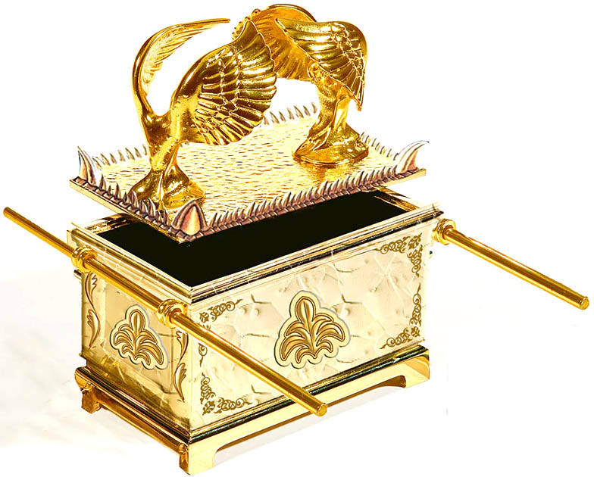
Shocking Truth #10
First
Covenant
The 10 Commandments were the legal
text of the abolished first covenant.
The text of the first covenant
was written on stone
Legal text of
First Covenant
“Tables of the Covenant” means
the text of the covenant was written on the tablets
“Ark of the Covenant” means the text of the covenant was inside the Ark box. The book of the law was on the outside of the ark.

Slide 21
Shocking Truth #10
First
Covenant
The 10 Commandments were the legal
text of the abolished first covenant.
The text of the first covenant
was written on stone
Legal text of
First Covenant
The Ten Commandments are the First Covenant which was abolished
Heb 8:13+ Col 2:14
“Ark of the Covenant” means
the text of the covenant was inside the Ark box

Slide 22
Shocking Truth #10
First
Covenant
The 10 Commandments were the legal
text of the abolished first covenant.
Both the first covenant INSIDE the Ark and the book of the law on the side of the ark was abolished.
Sabbatarians contradict the Bible: the covenant inside the Ark was not abolished but the book of the law on the side of the ark was abolished.
The book of the law is NEVER called the covenant.
Only the 10 commandments are called the covenant.
The Ten Commandments are the First Covenant which was abolished
Heb 8:13+ Col 2:14

Slide 23
Shocking Truth #9
$10,000 for one bible verse!
1. The word SABBATH in the book of Genesis.
2. Anyone who kept the Sabbath before the Exodus of Moses from Egypt.
3. The 4th commandment to keep the Sabbath in the New Testament.
4. Name the Christian who kept the Sabbath after resurrection.
5. Any group of Christians who kept the Sabbath before AD 1000
5 chances to win $10,000

Slide 24
Shocking Truth #9
$10,000 for one bible verse!
1. The word SABBATH in the book of Genesis.
The unique word for the weekly sabbath “sabbaton” is never used in Genesis.
The first time the word Sabbath is used is in Ex 16:23 after crossing the Red Sea and they were clearly UNFAMILAR with the Sabbath.
“This is what the Lord meant: Tomorrow is a sabbath observance, a holy sabbath to the Lord.” (Exodus 16:23)

Slide 25
Shocking Truth #9
$10,000 for one bible verse!
1. The word SABBATH in the book of Genesis.
2. Anyone who kept the Sabbath before the Exodus of Moses from Egypt.
Nobody before the Exodus kept the Sabbath.
Adam, Noah, and Abraham never kept the sabbath.
God rested on the 7th day of creation ONCE, but not every week afterwards, and Moses was the first to hear about it 4108 years later and then, God blessed the Sabbath for the first time as recorded in the 10 commandments.
Sabbath for Jews not Gentiles who were never in Egypt!
“You shall remember that you were a slave in the land of Egypt, and the Lord your God brought you out of there by a mighty hand therefore the Lord your God commanded you to observe the sabbath day.” (Deuteronomy 5:15)

Slide 26
Shocking Truth #9
$10,000 for one bible verse!
1. The word SABBATH in the book of Genesis.
2. Anyone who kept the Sabbath before the Exodus of Moses from Egypt.
Nobody before the Exodus kept the Sabbath.
Adam, Noah, and Abraham never kept the sabbath.
AD 150 Justin: “If there was no need of circumcision before Abraham, or Sabbaths before Moses, we don’t need either of them as Christians.”
AD 200 Tertullian: “Jews who demand the Sabbath is still to be observed must remember that God originated Adam uncircumcised, and inobservant of the Sabbath, and his offspring Abel, Noah, Enoch and Melchizedek offered Him sacrifices, uncircumcised and inobservant of the Sabbath.”
AD 300 Eusebius: “Noah and Abraham did not observe Sabbaths, nor do Christians.”

Slide 27
Shocking Truth #9
$10,000 for one bible verse!
1. The word SABBATH in the book of Genesis.
2. Anyone who kept the Sabbath before the Exodus of Moses from Egypt.
3. The 4th commandment quoted in the New Testament.
The 4th commandment is absent from the New Testament. Paul taught both the 4th and 10th commandments were abolished, and that the “Christian Sabbath that remains” is eternal rest in heaven, not the weekly sabbath.
“He has taken it out of the way, having nailed it to the cross. … Therefore let no one is to act as your judge regarding festival (yearly) or a new moon (monthly) or a Sabbath day (weekly)” (Colossians 2:14–16)

Slide 28
Shocking Truth #9
$10,000 for one bible verse!
3. The 4th commandment quoted in the New Testament.
The PATTERN OF Yearly, monthly, weekly proves it is the weekly sabbath in Col 2:16
 | Yearly | monthly | weekly
1 Chronicles 23:31 | fixed festivals | new moons | Sabbaths
2 Chronicles 2:4 | appointed feasts | new moons | Sabbaths
2 Chronicles 8:13 | annual feasts | new moons | Sabbaths
2 Chronicles 31:3 | fixed festivals | new moons | Sabbaths
Nehemiah 10:33 | appointed times | new moon | Sabbaths
Isa 1:13-14 | Appointed feasts | New moon | Sabbath
Ezekiel 45:17 | appointed feasts | new moons | Sabbaths
Ezek 46:1-11 | appointed feasts | new moons | Sabbath
Hosea 2:11 | festal assemblies | new moons | Sabbaths
Galatians 4:10 | years | months | days
Colossians 2:16 | festival | new moon | Sabbath day
“You observe days and months and seasons and years. I fear for you, that
perhaps I have labored over you in vain.” (Galatians 4:10–11)

Slide 29
Shocking Truth #9
$10,000 for one bible verse!
1. The word SABBATH in the book of Genesis.
2. Anyone who kept the Sabbath before the Exodus of Moses from Egypt.
3. The 4th commandment quoted in the New Testament.
The 10th commandment was
abolished in Romans 7:1-7
Thou shalt not covet
All Ten Commandments are abolished, but 9 were reinstated into the “Law of Christ” in the New Covenant. Under new law, it is a sin to covet (1 Cor 5:10).
AD 412 Augustine: “Which of the Ten commandments should Christians not keep
except the observance of the Sabbath, which ought not to be kept by a Christian.”
The 4th commandment was abolished in Col 2:14-17 so can break the sabbath without sin as Christians. There is no weekly day of rest for Christians.

Slide 30
Shocking Truth #9
$10,000 for one bible verse!
The 10th commandment was
abolished in Romans 7:1-7
Thou shalt not covet
Romans 7:1-2
“Dead to
the Law”
Romans 7:3
“Dead to
the Law
of Moses”
Moses
Husband
#1
Husband
#1
Woman
Bride
Church
Bride
“Alive to
Law of
Christ”
Christ
Husband
#2
Husband
#2

Slide 31
Shocking Truth #9
$10,000 for one bible verse!
The 10th commandment was
abolished in Romans 7:1-7
Thou shalt not covet
“Alive to
the Law”
Marriage
And
Divorce
Romans 7:1-2
Husband
#1
Woman
Bride
Husband
#2

Slide 32
Shocking Truth #9
$10,000 for one bible verse!
The 10th commandment was
abolished in Romans 7:1-7
Thou shalt not covet
Marriage
And
Divorce
Romans 7:1-2
Husband
#1
“Alive to
the Law”
Woman
Bride
“Alive to the Law”
X
Husband
#2

Slide 33
Shocking Truth #9
$10,000 for one bible verse!
The 10th commandment was
abolished in Romans 7:1-7
Thou shalt not covet
X
Marriage
And
Divorce
Romans 7:1-2
Husband
#1
“Dead to
the Law”
Woman
Bride
Husband
#2

Slide 34
Shocking Truth #9
$10,000 for one bible verse!
The 10th commandment was
abolished in Romans 7:1-7
Thou shalt not covet
Church Bride
Law of Moses
“Alive to
Law of
Moses”
Romans 7:3
Moses
Husband
#1
Church
Bride
Christ
Husband
#2

Slide 35
Shocking Truth #9
$10,000 for one bible verse!
The 10th commandment was
abolished in Romans 7:1-7
Thou shalt not covet
Church Bride
Sabbath
+
Law of Christ
Romans 7:3
“Alive to
Law of
Moses”
Moses
Husband
#1
Church
Bride
“Alive to the Law”
X
Christ
Husband
#2

Slide 36
Shocking Truth #9
$10,000 for one bible verse!
The 10th commandment was
abolished in Romans 7:1-7
Thou shalt not covet
Church Bride
Law of Moses
+
Law of Christ
X
Romans 7:3
“Dead to
the Law
of Moses”
Moses
Husband
#1
Church
Bride
“Alive to
Law of
Christ”
Christ
Husband
#2

Slide 37
Shocking Truth #9
$10,000 for one bible verse!
The 10th commandment was
abolished in Romans 7:1-7
Thou shalt not covet
“Alive to
the Law”
“Alive to
Law of
Moses”
Romans 7:1-2
Romans 7:3
Moses
Husband
#1
Husband
#1
Woman
Bride
Marriage
and Divorce
Church
Bride
CHURCH
Christ
Husband
#2
Husband
#2

Slide 38
Shocking Truth #9
$10,000 for one bible verse!
The 10th commandment was
abolished in Romans 7:1-7
Thou shalt not covet
Romans 7:1-2
Romans 7:3
“Alive to
Law of
Moses”
Marriage
and Divorce
“Alive to
the Law”
Moses
Husband
#1
Husband
#1
CHURCH
Woman
Bride
Church
Bride
“Alive to the Law”
“Alive to
Law of
Christ”
X
Christ
Husband
#2
X
Husband
#2

Slide 39
Shocking Truth #9
$10,000 for one bible verse!
The 10th commandment was
abolished in Romans 7:1-7
Thou shalt not covet
X
X
Romans 7:1-2
“Dead to
the Law”
Romans 7:3
“Dead to
the Law
of Moses”
Moses
Husband
#1
Husband
#1
Woman
Bride
Marriage
and Divorce
Church
Bride
CHURCH
“Alive to the Law”
“Alive to
Law of
Christ”
Christ
Husband
#2
Husband
#2

Slide 40
Shocking Truth #9
$10,000 for one bible verse!
The 10th commandment was
abolished in Romans 7:1-7
Thou shalt not covet
Christians who keep the Sabbath are spiritual adulterers.
“You who are seeking to be justified by law, you have been severed from Christ and have fallen from grace.” (Gal 5:4)

Slide 41
Shocking Truth #9
$10,000 for one bible verse!
The 10th commandment was
abolished in Romans 7:1-7
Thou shalt not covet
Christians who keep the Sabbath are spiritual adulterers.
“severed/fallen from grace.” (Gal 5:4)
AD 350 Cyril: “Do not fall away into Judaism by keeping Sabbaths.”

Slide 42
Shocking Truth #9
$10,000 for one bible verse!
The 10th commandment was
abolished in Romans 7:1-7
Thou shalt not covet
What Law is abolished in Romans 7:1-7?
“But now we have been released from the Law, having died to that by which we were bound. What shall we say then? Is the Law sin? May it never be! On the contrary, I would not have come to know sin except through the Law for I would not have known about coveting if the Law had not said, “YOU SHALL NOT COVET.”” (Romans 7:6–7)

Slide 43
Shocking Truth #9
$10,000 for one bible verse!
The 10th commandment was
abolished in Romans 7:1-7
Thou shalt not covet
What Law is abolished in Romans 7:1-7?
“But now we have been released from the Law, having died to that by which we were bound. What shall we say then? Is the Law sin? May it never be! On the contrary, I would not have come to know sin except through the Law for I would not have known about coveting if the Law had not said, “YOU SHALL NOT COVET.”” (Romans 7:6–7)

Slide 44
Shocking Truth #9
$10,000 for one bible verse!
The 10th commandment was
abolished in Romans 7:1-7
Thou shalt not covet
What Law is abolished in Romans 7:1-7?
“But now we have been released from the Law, having died to that by which we were bound. What shall we say then? Is the Law sin? May it never be! On the contrary, I would not have come to know sin except through the Law for I would not have known about coveting if the Law had not said, “YOU SHALL NOT COVET.”” (Romans 7:6–7)

Slide 45
Shocking Truth #9
$10,000 for one bible verse!
The 10th commandment was
abolished in Romans 7:1-7
Thou shalt not covet
Romans 7:7
10th Abolished:
Thou shalt not Covet

Slide 46
Shocking Truth #9
$10,000 for one bible verse!
The 10th commandment was
abolished in Romans 7:1-7
Thou shalt not covet
Christians who keep the
Ten Commandments
are spiritual adulterers.
“You who are seeking to be justified by law, you have been severed from Christ and have fallen from grace.” (Gal 5:4)

Slide 47
Shocking Truth #9
$10,000 for one bible verse!
The 10th commandment was
abolished in Romans 7:1-7
Thou shalt not covet
First Covenant
Law of Moses is the
10 Commandments
Law of Christ
Gal 6:2

Slide 48
Which Law do Christians keep?
Law of Moses
Heb 8:13
Law of Christ
Gal 6:2
Which Law will YOU keep?

Slide 49
Shocking Truth #9
$10,000 for one bible verse!
1. The word SABBATH in the book of Genesis.
2. Anyone who kept the Sabbath before the Exodus of Moses from Egypt.
3. The 4th commandment quoted in the New Testament.
“There remains a sabbath rest”
The Christian Sabbath is a continuous eternal rest in heaven, not just one day a week. Heb 4
I want heaven 7 days a week, Adventist heaven is only one day a week!
"For if Joshua had given them rest, He would not have spoken of another day after that. So there remains a Sabbath rest for the people of God. For the one who has entered His rest has himself also rested from his works, as God did from His." (Hebrews 4:8–10)
Joshua kept the Sabbath and gave them physical rest in Canaan, (Josh 21:44; 22:4)
Just as God has rested continuously since the day 7th day of creation, (God doesn’t keep the weekly sabbath), so too Christians will consciously rest forever when they enter heaven (not just one day a week)

Slide 50
Shocking Truth #9
$10,000 for one bible verse!
1. The word SABBATH in the book of Genesis.
2. Anyone who kept the Sabbath before the Exodus of Moses from Egypt.
3. The 4th commandment quoted in the New Testament.
4. Name the Christian who kept the 7th day Sabbath after resurrection.
The only church service recorded in the Bible occurred on the 1st day of the week. No Christian is recorded as keeping the 7th day Sabbath.
“On the first day of the week, when we were gathered together to break bread.” (Acts 20:7)
Eating common meals while assembles was forbidden: (1 Cor 11:3)
“On the first day of every week each one of you is to put aside and save, so that no collections be made when I come. (1 Cor 16:1–3)
Must be an assembly collection because if each saved up at home, it would require a collection.

Slide 52
Shocking Truth #9
$10,000 for one bible verse!
1. The word SABBATH in the book of Genesis.
2. Anyone who kept the Sabbath before the Exodus of Moses from Egypt.
3. The 4th commandment quoted in the New Testament.
4. Name the Christian who kept the 7th Sabbath after resurrection.
Arguing Paul kept the Sabbath 84 times teaching Jews about Jesus in synagogues is absurd.
A Sabbatarian preaching in a mosque doesn't make him a Friday-keeper of “Youm Jumu’ah”
A Jew preaching in a church doesn’t make him a Sunday-keeper
Paul preaching in a Synagogue doesn’t make him a Sabbath-keeper
I am not a Sabbath-keeper if I preach in a Seventh-day Adventist church.

Slide 53
Shocking Truth #9
$10,000 for one bible verse!
1. The word SABBATH in the book of Genesis.
2. Anyone who kept the Sabbath before the Exodus of Moses from Egypt.
3. The 4th commandment quoted in the New Testament.
4. Name the Christian who kept the 7th Sabbath after resurrection.
5. Name the historic group of Christians who kept the Sabbath before AD 1000
The universal record of history proves Christians never kept the sabbath and always assembled for worship on Sunday, the 1st day of the week.
Sunday was never called the Christian Sabbath until AD 1600 and in AD 1863 Ellen G. White changed the historic day of Christian worship from Sunday to Saturday because of a demonic vision.

Slide 54
Shocking Truth #9
$10,000 for one bible verse!
5. Name the historic group of Christians who kept the Sabbath before AD 1000
AD 100 Barnabas: “We keep the Sunday on which Jesus rose again from the dead.”
AD 150 Justin: “Sunday is the day on which we all hold our common assembly.”
AD 200 Tertullian: “We solemnize Sunday, the day after Saturday in contrary to the Jews, who call this day their Sabbath … the observance of the Sabbath is demonstrated to have been temporary.”
AD 250 Cyprian: “The eighth day is the Lord's Day, being the first day after the Sabbath."
AD 350 Constitutions: "On the Lord's day, the day of resurrection, assemble yourselves together without fail.”
AD 350 Cyril: “Do not fall away into Judaism by keeping Sabbaths.”
AD 360 Council of Laodicea: “Christians should not Judaize by being idle on
the Sabbath, but should work on that day; they should, however, particularly
reverence the Lord's day and, if possible, not work on it, because they were
Christians.”

Slide 55
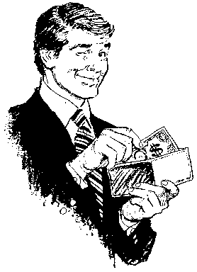
Shocking Truth #9
$10,000 for one bible verse!
1. The word SABBATH in the book of Genesis.
2. Anyone who kept the Sabbath before the Exodus of Moses from Egypt.
3. The 4th commandment to keep the Sabbath in the New Testament.
4. Name the Christian who kept the Sabbath after resurrection.
5. Name the group of Christians who kept the Sabbath before AD 1000
NO WINNER

Slide 56
Shocking Truth #8
25 Reasons why Sunday is important to Christians, zero reasons for the Sabbath
The Lord’s day is Sunday, when Jesus rose from the dead, not the Sabbath: Mk 16:9; Lk 24:1,13,21
All 6 appearances of Jesus happen on Sundays, never on a Sabbath. Mk 16:9; Mt 28:5-9; Lk 24:34; Lk 24:13-15; Lk 24:33,36 + Jn 20:19; Jn 20:26
Christians are recorded assembling three times on Sunday after resurrection and before ascension, never on the Sabbath. Jn 20:19 Jn 20:26 Acts 2:1.
The only church worship service by Christians was on a Sunday, never on the Sabbath: Acts 20:7
Christians are commanded every Sunday to give into a common treasury of the church: 1 Cor 16:1-2
The only day ever mentioned when Christians broke bread was on Sunday: Acts 20:7
Jesus was declared the Son of God on Sunday: Rom 1:4
Ps 2:7 "Today I have begotten thee“, fulfilled on Sunday when he rose: Acts 13:33
The sign that Jesus was glorified was given on Sunday: Jn 7:39 + Acts 2:1,32
The church began on Pentecost Sunday: Acts 2:1. Pentecost always fell on a Sunday.
Jesus was crowned king on a Sunday: Acts 2:33-36
The disciple’s reception of the promise of the Father on Sunday: Acts 1:4-5; 2:1-4
The Holy Spirit first fell upon the apostles on a Sunday: Acts 2:1-4
Salvation first preached by Peter on Sunday: Mt 16:19; Acts 2:1,38,40-41
The Keys to the Kingdom of God were first used on Sunday: Mt 16:19

Slide 57
Shocking Truth #8
$10,000 for one bible verse!
25 Reasons why Sunday is important to Christians, zero reasons for the Sabbath
The great "Triumphal entry" (also called "Palm Sunday") happened on the first day: Luke 13:32
The time between the Lord's resurrection (sheaf waving day) and Pentecost was Sunday to Sunday counting of 50 days. The starting and stopping time was on the 1st day.
First time Jesus worshiped after resurrection was on the first day by Thomas (Jn. 20:26).
The first time we could be born again to a living hope was on a Sunday: 1 Pet. 1:3
The first time Jesus had communion after his resurrection with His disciples, was on a Sunday: (Lk. 24:1, 13, 28-35)
Pentecost was a Sunday - Sunday duration of 50 days. The starting point and stopping point of counting the 50 days was a Sunday - Sunday period!
The 1st day is specifically pointed out in scripture. There is no example of Christians assembling on the Sabbath (7th). No other day is ever specifically mentioned in NT: i.e., "4th day".
"Lord's" is used only 2X in NT: "Lord’s Day" & "Lord's supper" Rev 1:10; 1 Cor 11:20; Acts 20:7. Christian partake of the Lord's supper on the Lord’s Day as a memorial of when he rose from the dead. We know the Lord's supper was partaken of on Sunday by all early Christian.
The universal record of history proves all Christians partook of the Lord’s supper on the 1st day of the week, which they called, the “Lord’s Day”, because they understood Sunday was the day Jesus rose from the dead.
While the Sabbath was significant to the Jews, there is no New Testament significance of the Sabbath in connection with anything of Christ, Christianity, the church, or heaven!

Slide 58
Shocking Truth #8
$10,000 for one bible verse!
25 Reasons why Sunday is important to Christians, zero reasons for the Sabbath

Slide 59
Shocking Truth #7
The Sabbath and circumcision were signs of the First Covenant (nailed to cross).
Two signs of the first covenant:
Sabbath a sign between God and Jews not Gentiles: Ex 31:13-17; Ezek 20:12
“You shall keep My sabbaths, for this is a sign between Me and you throughout your generations.” (Exodus 31:13)
The sabbath was a memorial of Egyptian slavery for Jews, not Gentiles. This proves the sabbath did not exist BEFORE the Exodus.
“Remember that you were a slave in Egypt, and the God brought you out with a mighty hand, therefore God commanded you to observe the sabbath day.” (Deut 5:15)
Circumcision a sign between God and Jews, not Gentiles:
"And you shall be circumcised and it shall be the sign of the covenant between Me and you throughout your generations.” (Gen 17:11)

Slide 60
Shocking Truth #6
Matthew 5:17 says Jesus abolished the Law of Moses!
“I came, not to abolish the Law or the Prophets, I came to fulfill. Until heaven and earth pass away, not the smallest letter or stroke shall pass from the Law until all is fulfilled.” (Mt 5:17–18, kjv)
Two conditions
The Law will remain in force forever,
until Jesus fulfilled the Law.
Parent to child at dinner table: “Until bedtime you are going to remain at the table until you eat all your dinner.”
Did Jesus Fulfill the Law? Yes.
“Jot and Tittle” includes animal sacrifices.

Slide 61
Shocking Truth #5
God never changes, but His law has changed many times.
“I, the Lord, do not change, therefore my law never changes” (Malachi 3:6, SDA Bible)
Changes in God’s Law:
“When the priesthood changes, of necessity, the law changes also.” (Heb 7:12)
“He said “A new covenant”, made the first obsolete.” (Jer 31:31; Heb 8:13)
Kosher Food Laws:
NO: Vegetarian before the Flood (5554 – 3298 BC)
NO: Non-kosher meat eaters after Flood till Moses: Gen 9:3 (3298 – 1446 BC)
YES: Kosher Moses to Christ: no bacon (1446 BC – AD 33)
ABOLISHED: Eat anything: BACON PLEASE!!! After cross (AD 33 – Present)
Circumcision:
NO: Adam to Abraham (5554 – 2167 BC)
YES: Abraham to cross (2167 BC – AD 33)
ABOLISHED: For Christians (AD 33 – present)
Tabernacle worship with animal sacrifices and Aaronic priesthood:
NO: Adam to Moses (5554 – 1446 BC)
YES: Moses to Cross: Hundreds of new Mosaic laws (1446 BC – AD 33)
ABOLISHED: For Christians (AD 33 – present)
Sabbath Rest on 7th day:
NO: Adam to Moses: (5554 – 1446 BC)
YES: Moses to Christ, Jews only: (1446 BC – AD 33)
ABOLISHED: For Christians (AD 33 – present)

Slide 62
Shocking Truth #4
Sometimes, following the example of Jesus is the wrong thing to do.
“If we must keep the Sabbath because Jesus our example kept the Sabbath, then we must also keep animal sacrifices because Jesus commanded a man to make a sacrifice.
Jesus cleansed a leper:
Jesus touched the leper and healed him then commanded, Go, show yourself to the priest and offer for your cleansing what Moses commanded, as a testimony to them.” (Mark 1:40–44)
Do not follow Jesus’ example:
Do not offer animal sacrifices.
Do not touch a leper, as you can catch Leprosy.
Do not keep the Sabbath

Slide 63
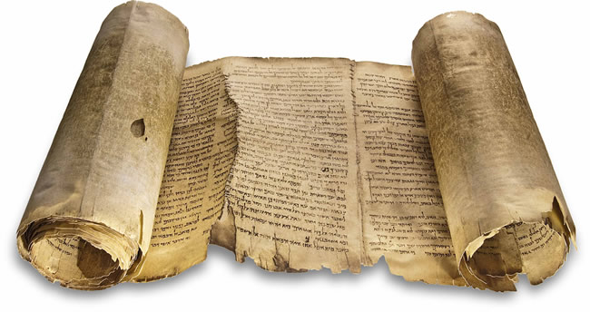
Shocking Truth #3
It is impossible to divide the Law of Moses into Moral and Ceremonial partitions.
Law of Moses
Ten Commandments
(Moral Law?)
Book of the Law
Ceremonial Law?
The 4th Sabbath commandment is a ceremonial law
10 commandments recorded twice.
The two greatest moral laws are found in the Book of the Law.
Deut 6:5; Lev 19:18

Slide 64
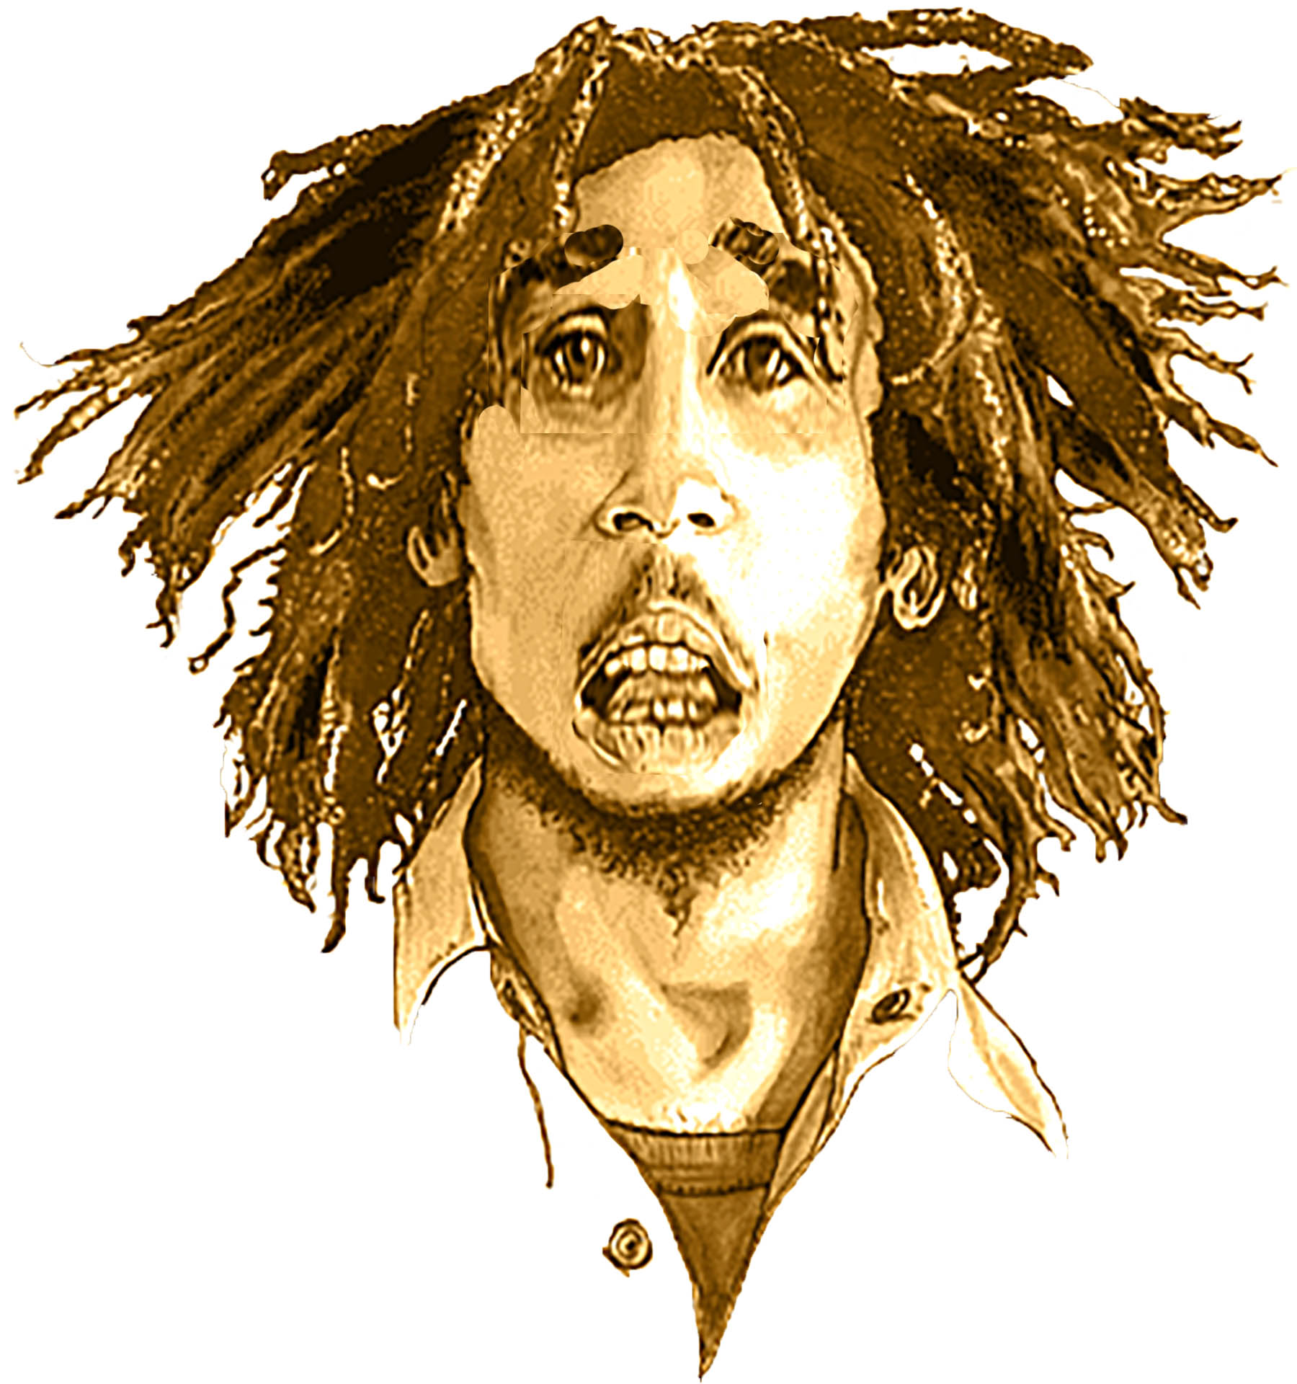
Shocking Truth #2
Forever in the Bible comes to an end!
“Ex 31:16 says the Sabbath is forever”
“Forever [Olam] through your generations”
Circumcision | Circumcision | Gen 17:12-13
Jonah | Was Jonah “forever” in Whale? | Jonah 2:6
Tabernacle Worship | Altar of Incense | Ex 30:8
 | Minora Candlestick | Ex 27:21
 | Laver Foot/Handwashing | Ex 30:21
 | Burnt Offerings | Lev 3:17
 | Grain Offerings | Lev 23:14
 | Levitical Priesthood | Num 18:23
 | Offering of Red Heifer | Num 19:10
Ceremonial Holy Days | Pentecost/Shauvot | Lev 23:21
 | Passover/Pesach | Ex 12:14
 | Trumpets/Yom Kippur | Num 10:8
 | Tabernacles/Sukkot | Lev 23:41
 | Unleavened Bread/Erev Pesach | Ex 12:17
 | Sabbath | Ex 31:16
“Isn’t the Sabbath Forever?”

Slide 65
Shocking Truth #2
Forever in the Bible comes to an end!
“Ex 31:16 says the Sabbath is forever”
“Don’t worry, be happy!

Slide 66
Shocking Truth #2
Forever in the Bible comes to an end!
Circumcision | Sabbath | Passover Memorial of Exodus | Sign of first covenant | Forever = Hebrew “Olam”
 | Circumcision | Sabbath | Passover
“Forever/Olam through your generations” | Genesis 17:12-13 | Exodus 31:16 | Exodus 12:14
“Forever/Olam (first) Covenant” | Genesis 17:13 | Exodus 31:16 | —
“Memorial of the Exodus” | — | Deut 5:15 | Exodus 12:14
Sign of (first) covenant | Genesis 17:11 | Exodus 31:13 | Exodus 12:13
“I will make a new covenant with the house of Israel” (Jeremiah 31:31) “He said “A new covenant” and made the first obsolete.” (Hebrews 8:13)

Slide 67
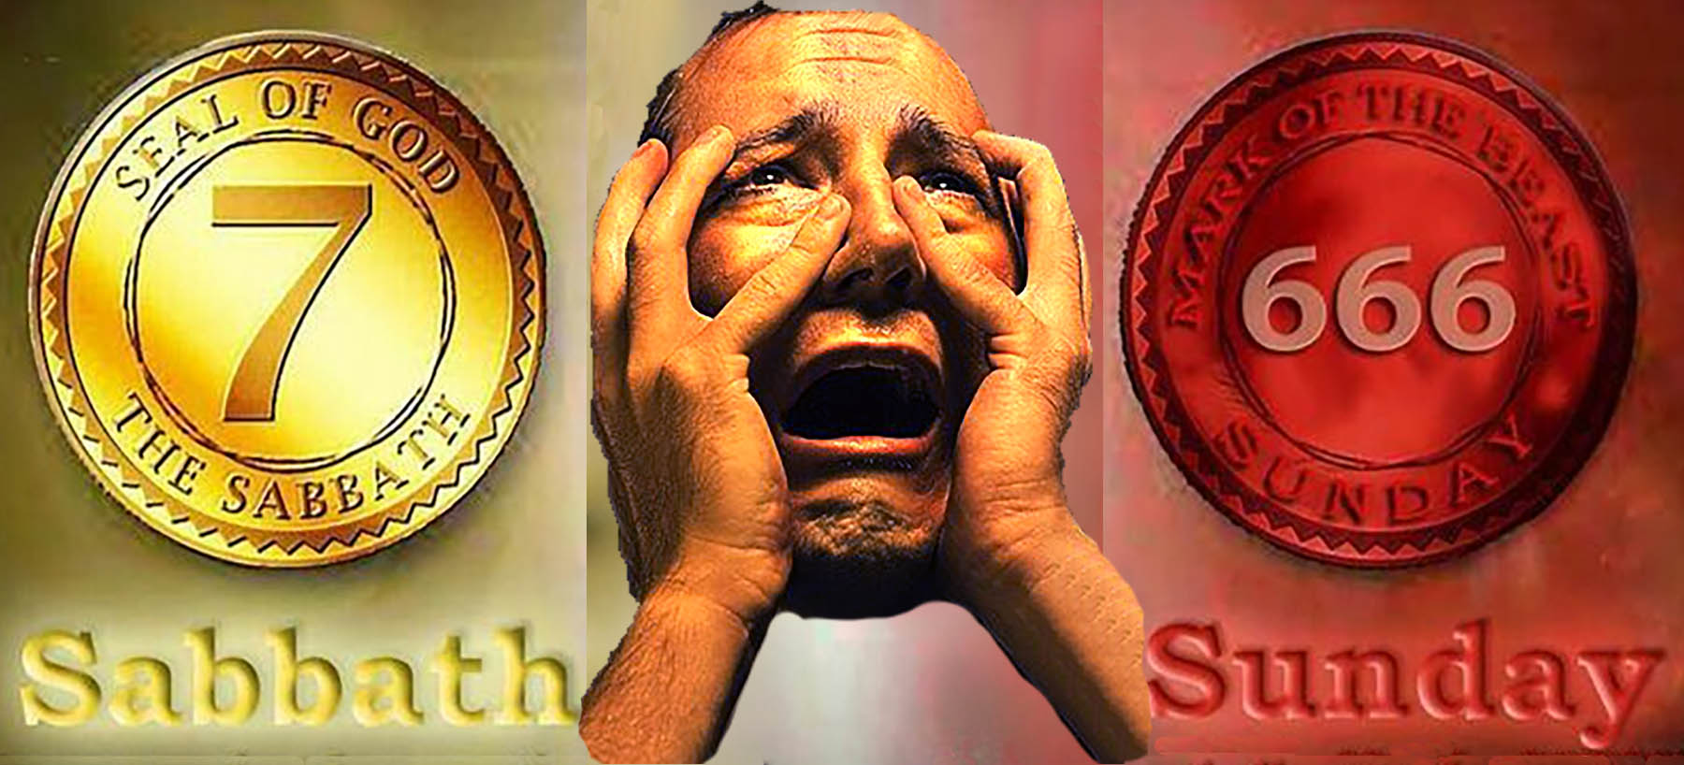
Did the Pope change the Sabbath?
Is Sunday worship the mark fo the Beast?

Slide 68
Shocking Truth #1
The Pope didn’t change the Sabbath, it was abolished by Jesus

Slide 69
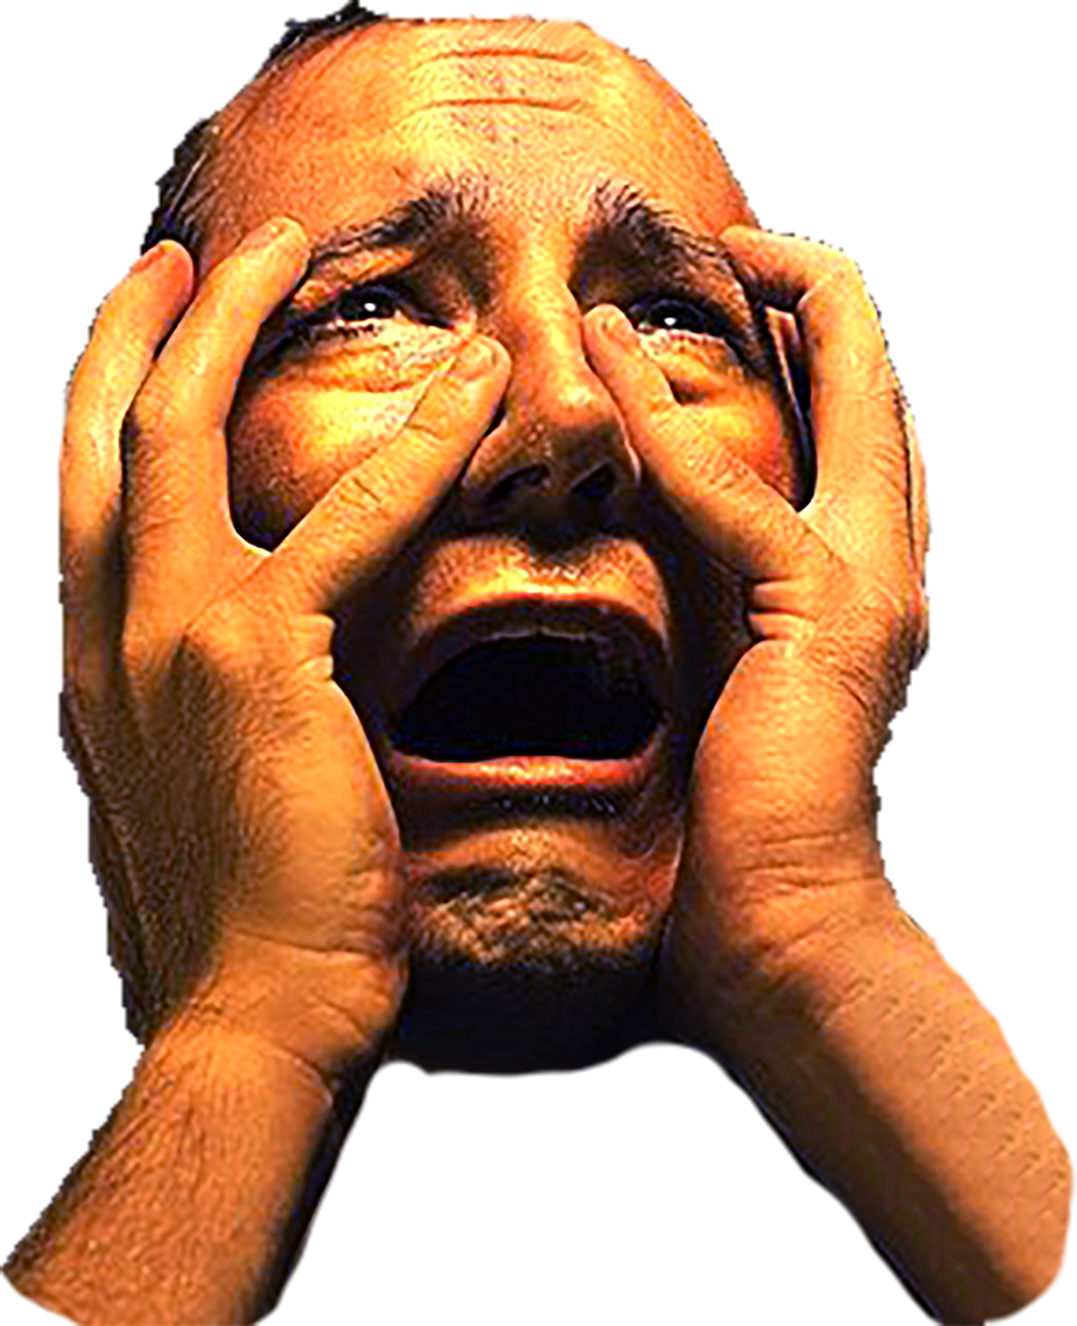
Shocking Truth #1
The Pope didn’t change the Sabbath, it was abolished by Jesus.
Christians have always worshipped on the 1st day of the week.
Unicorn theories of Sabbatarians
“Inspired prophet” Ellen G. White: The Pope in AD 325
“Mistaken prophet” Ellen G. White: Constantine in AD 321
“SDA scholar” Samuele Bacchiocchi: Hadrian in AD 135
Ellen White was a false prophet!

Slide 70
Who changed the day of Christian worship?
Ellen G. White
666?
Ellen G. White spoke out against the Most High by making alterations in times and in law.” (Daniel 7:25)

Slide 71
14 Foster Ave beside Jarret Park

Slide 72
Find a local church that worships on Sunday like the Bible commands
www.bible.ca/directory/seek.php
www.bible.ca/sabbath.htm
Steven Rudd, Canada, 2023

