Slide 2
THE TREE OF LIFE:
Lost & Found
Rev. 22:1-2

Slide 3
THE TREE OF LIFE:
Lost & Found
Introduction
1. Rev. 22:1-2 The tree of life: lost at Eden,
found in heaven!

Slide 4
1. Rev. 22:1-2 The tree of life: lost at Eden,
found in heaven!
1 And he shewed me a pure river of water of life,
clear as crystal,
proceeding out of the throne of God and of the Lamb.
2 In the midst of the street of it,
and on either side of the river,
was there the tree of life,
which bare twelve manner of fruits,
and yielded her fruit every month:
and the leaves of the tree were for the healing
of the nations.

Slide 5
THE TREE OF LIFE:
Lost & Found
Introduction
2. How was it lost, how do we find it?
  The tree of life sustained man in fellowship with God
  Sin separated man from God & the tree of life
  God revealed a plan to renew our fellowship
  We find eternal fellowship with God in heaven: the tree of life awaits us there!

Slide 6
THE TREE OF LIFE:
Lost & Found
I. The Tree of Life Sustained Man
in Fellowship with God
A. Man Was Created for Fellowship with God
  Gen. 1:27 Only man is made in God’s image
27 So God created man in his own image,
in the image of God created he him;
male and female created he them.

Slide 7
THE TREE OF LIFE:
Lost & Found
I. The Tree of Life Sustained Man
in Fellowship with God
B. God Made Man to Live, Not to Die
  Gen. 2:8-9 Man blessed by 3 kinds of trees

Slide 8
Gen. 2:8-9 Man blessed by 3 kinds of trees
8 And the LORD God planted a garden
eastward in Eden;
and there he put the man whom he had formed.
9 And out of the ground made the LORD God to grow every tree that is pleasant to the sight,
and good for food;
the tree of life also in the midst of the garden,
and the tree of knowledge of good and evil.
Trees: delicious food
Tree: perpetuate life
Tree: choose good or evil

Slide 9
THE TREE OF LIFE:
Lost & Found
I. The Tree of Life Sustained Man
in Fellowship with God
C. Eden Means Delight, Bliss, Paradise!
  Gen. 2:10-14 River with 4 tributaries, land filled with precious metals & minerals
  Gen. 2:18-25 Adam & Eve shared Eden’s bliss & fellowship with God

Slide 10
THE TREE OF LIFE:
Lost & Found
II. Sin Separated Man from God & the Tree of Life
A. Man Has Free Will to Love & Obey or Reject God
  Gen. 2:16-17 God warned sin brings death
16 And the LORD God commanded the man, saying,
Of every tree of the garden thou mayest freely eat:
17 But of the tree of the knowledge of good and evil, thou shalt not eat of it:
for in the day that thou eatest thereof
thou shalt surely die.

Slide 11
THE TREE OF LIFE:
Lost & Found
II. Sin Separated Man from God & the Tree of Life
B. Satan Presented Sin as a Blessing
  Gen. 3:4-6 Eve & Adam chose the lie

Slide 12
Gen. 3:4-6 Eve & Adam chose the lie
4 And the serpent said unto the woman,
Ye shall not surely die:
5 For God doth know that in the day ye eat thereof, then your eyes shall be opened,
and ye shall be as gods, knowing good and evil.
6 And when the woman saw
that the tree was good for food,
and that it was pleasant to the eyes,
and a tree to be desired to make one wise,
she took of the fruit thereof, and did eat,
and gave also unto her husband with her;
and he did eat.

Slide 13
THE TREE OF LIFE:
Lost & Found
II. Sin Separated Man from God & the Tree of Life
C. Adam & Eve Died Spiritually
  Gen. 3:8 The beautiful blissful fellowship was replaced with guilt, shame, & fear
8 And they heard the voice of the LORD God
walking in the garden in the cool of the day:
and Adam and his wife hid themselves
from the presence of the LORD God
amongst the trees of the garden.

Slide 14

THE TREE OF LIFE:
Lost & Found
II. Sin Separated Man from God & the Tree of Life
D. Adam & Eve Lost the Tree of Life
  Gen. 3:19 The sentence of death pronounced
19 In the sweat of thy face shalt thou eat bread, till thou return unto the ground;
for out of it wast thou taken:
for dust thou art,
and unto dust shalt thou return.

Slide 15
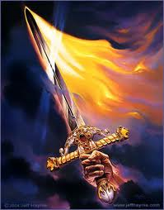
THE TREE OF LIFE:
Lost & Found
II. Sin Separated Man from God & the Tree of Life
D. Adam & Eve Lost the Tree of Life
  Gen. 3:24 Man could not return to the tree
24 So he drove out the man;
and he placed at the east of the garden of Eden Cherubims,
and a flaming sword which turned every way,
to keep the way of the tree of life.

Slide 16
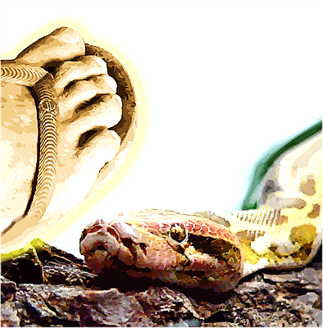
THE TREE OF LIFE:
Lost & Found
III. God Revealed a Plan to Renew Our Fellowship
A. In the Patriarchal Age God Promised a Savior
  Gen. 3:15 Seed of woman will defeat Satan
15 And I will put enmity between thee and the woman, and between thy seed and her seed;
it shall bruise thy head, and thou shalt bruise his heel.

Slide 17
THE TREE OF LIFE:
Lost & Found
III. God Revealed a Plan to Renew Our Fellowship
A. In the Patriarchal Age God Promised a Savior
  Gen. 12:1-3 Seed of Abraham will bless men of all nations

Slide 18
12:1-3 Seed of Abraham will bless men of all nations
1 Now the LORD had said unto Abram,
Get thee out of thy country, and from thy kindred, and from thy father's house,
unto a land that I will shew thee:
2 And I will make of thee a great nation,
and I will bless thee, and make thy name great;
and thou shalt be a blessing:
3 And I will bless them that bless thee,
and curse him that curseth thee:
and in thee shall all families of the earth be blessed.
CANAAN
ISRAEL
CHRIST

Slide 19
THE TREE OF LIFE:
Lost & Found
III. God Revealed a Plan to Renew Our Fellowship
A. In the Patriarchal Age God Promised a Savior
  Promise repeated to Abraham’s descendants: Isaac, Jacob, Judah, etc.

Slide 20
THE TREE OF LIFE:
Lost & Found
III. God Revealed a Plan to Renew Our Fellowship
B. In the Mosaic Age God Prepared to Send a Savior
  Jacob’s family went to Egypt 400 years, then Moses led the Jews to Canaan

Slide 21
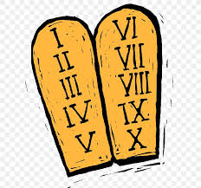
THE TREE OF LIFE:
Lost & Found
III. God Revealed a Plan to Renew Our Fellowship
B. In the Mosaic Age God Prepared to Send a Savior
  Ex. 20:1-17 God gave Moses His covenant or law for the nation of Israel, beginning with The Ten Commandments
1 And God spake all these words, saying,
2 I am the LORD thy God,
which have brought thee out of the land of Egypt,
out of the house of bondage.

Slide 22
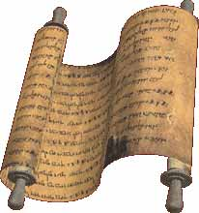
THE TREE OF LIFE:
Lost & Found
III. God Revealed a Plan to Renew Our Fellowship
B. In the Mosaic Age God Prepared to Send a Savior
  Jer. 31:31 Moses’ Law was temporary, preparing the people for the New Law of Christ
31 Behold, the days come, saith the LORD,
that I will make a new covenant
with the house of Israel,
and with the house of Judah:

Slide 23
THE TREE OF LIFE:
Lost & Found
III. God Revealed a Plan to Renew Our Fellowship
B. In the Mosaic Age God Prepared to Send a Savior
  God gave Israel kings: Saul, David, Solomon
  Isa. 9:6 Israel’s kings were temporary, preparing for Christ the new perfect divine King
6 For unto us a child is born, unto us a son is given:
and the government shall be upon his shoulder:
and his name shall be called Wonderful, Counsellor,
The mighty God, The everlasting Father,
The Prince of Peace.

Slide 24
THE TREE OF LIFE:
Lost & Found
III. God Revealed a Plan to Renew Our Fellowship
B. In the Mosaic Age God Prepared to Send a Savior
  God made Israel a great kingdom
  Dan. 2:44 The kingdom of Israel was temporary, preparing for the new kingdom (church of Christ)

Slide 25

Dan. 2:44 The kingdom of Israel was temporary, preparing for the new kingdom (church of Christ)
44 And in the days of these kings
shall the God of heaven set up a kingdom,
which shall never be destroyed:
and the kingdom shall not be left to other people, but it shall break in pieces and consume
all these kingdoms,
and it shall stand for ever.

Slide 26
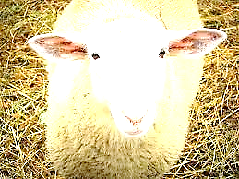
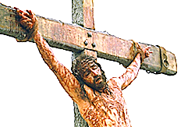
THE TREE OF LIFE:
Lost & Found
III. God Revealed a Plan to Renew Our Fellowship
B. In the Mosaic Age God Prepared to Send a Savior
  God taught Israel to offer animal sacrifices
  Isa. 53:5-6 Animal sacrifices were temporary, preparing for Christ the perfect sacrifice for sin

Slide 27
Isa. 53:5-6 Animal sacrifices were temporary, preparing for Christ the perfect sacrifice for sin
5 But he was wounded for our transgressions,
he was bruised for our iniquities:
the chastisement of our peace was upon him;
and with his stripes we are healed.
6 All we like sheep have gone astray;
we have turned every one to his own way;
and the LORD hath laid on him the iniquity of us all.

Slide 28
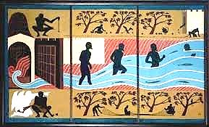
THE TREE OF LIFE:
Lost & Found
III. God Revealed a Plan to Renew Our Fellowship
B. In the Mosaic Age God Prepared to Send a Savior
  God taught Israel to worship at the temple
  Ezek. 47:12 Israel’s temple was temporary, preparing for the new temple (church of Christ) with the river of life & the tree of life

Slide 29
Ezek. 47:12 Israel’s temple was temporary, preparing for the new temple (church of Christ) with the river of life & the tree of life
12 And by the river upon the bank thereof,
on this side and on that side,
shall grow all trees for meat,
whose leaf shall not fade,
neither shall the fruit thereof be consumed:
it shall bring forth new fruit according to his months, because their waters they issued out of the sanctuary: and the fruit thereof shall be for meat,
and the leaf thereof for medicine.

Slide 30
THE TREE OF LIFE:
Lost & Found
III. God Revealed a Plan to Renew Our Fellowship
C. In the Gospel Age Our Savior is Here!
  Matt. 1:21; Lk. 2:10-11 Angels announced Christ as the Savior

Slide 31
Matt. 1:21; Lk. 2:10-11 Angels announced Christ as the Savior
21 And she shall bring forth a son,
and thou shalt call his name JESUS:
for he shall save his people from their sins.
10 And the angel said unto them, Fear not:
for, behold, I bring you good tidings of great joy, which shall be to all people.
11 For unto you is born this day in the city of David a Saviour, which is Christ the Lord.

Slide 32
THE TREE OF LIFE:
Lost & Found
C. In the Gospel Age Our Savior is Here!
  In Christ & his church, we find:
    Seed of woman who defeats Satan
    Seed of Abraham who blesses all men
    Christ’s new covenant, testament, or law
    Our new King
    The new kingdom of God
    The perfect sacrifice for our sins
    The new temple with river of life & tree of life

Slide 33
THE TREE OF LIFE:
Lost & Found
III. God Revealed a Plan to Renew Our Fellowship
C. In the Gospel Age Our Savior is Here!
  Matt. 16:16-19 The Savior built his church by sending his Apostles to proclaim salvation

Slide 34
Matt. 16:16-19 The Savior built his church by sending his Apostles to proclaim salvation
16 And Simon Peter answered and said,
Thou art the Christ,
the Son of the living God.
17 And Jesus answered and said unto him,
Blessed art thou, Simon Barjona:
for flesh and blood hath not revealed it unto thee,
but my Father which is in heaven.
18 And I say also unto thee, That thou art Peter,
and upon this rock
I will build my church;
and the gates of hell shall not prevail against it.

Slide 35
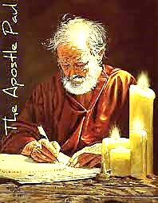
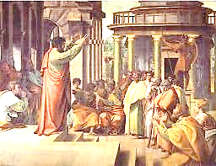
Matt. 16:16-19 The Savior built his church by sending his Apostles to proclaim salvation
19 And I will give unto thee the keys
of the kingdom of heaven:
and whatsoever thou shalt bind on earth
shall be bound in heaven:
and whatsoever thou shalt loose on earth
shall be loosed in heaven.

Slide 36
THE TREE OF LIFE:
Lost & Found
III. God Revealed a Plan to Renew Our Fellowship
C. In the Gospel Age Our Savior is Here!
  Matt. 28:18-20 The Savior calls all men to submit to the gospel & receive salvation

Slide 37
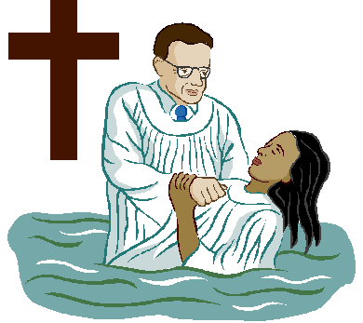
Matt. 28:18-20 The Savior calls all men to submit to the gospel & receive salvation
18 And Jesus came and spake unto them, saying, All power is given unto me in heaven and in earth.
19 Go ye therefore, and teach all nations, baptizing them in the name of the Father,
and of the Son, and of the Holy Ghost:
20 Teaching them to observe all things whatsoever I have commanded you:
and, lo, I am with you alway,
even unto the end of the world. Amen.

Slide 38
THE TREE OF LIFE:
Lost & Found
III. God Revealed a Plan to Renew Our Fellowship
D. God Perfectly Fulfilled His Plan to Save Us:
the Gospel Age Began in Acts 2!

Slide 39

PATRIARCHAL AGE
Adam to Moses
MOSAIC AGE
Moses to Christ
GOSPEL AGE
Christ to End
A.D. 33
CHRIST Reigns
The Gospel
1800 B.C.
PROMISE TO ABRAM:
SAVIOR
Gen. 12:3
1400 B.C.
LAW OF MOSES
Ex. 20
ACTS 2

Slide 40
THE TREE OF LIFE:
Lost & Found
  IV. We Find Eternal Fellowship with God in Heaven:
  the Tree of Life Awaits Us There!
A. Fellowship with God Makes Heaven Heaven
  Rev. 22:1-4 The water of life & the tree of life

Slide 41
1 And he shewed me a pure river of water of life,
clear as crystal,
proceeding out of the throne of God and of the Lamb.
2 In the midst of the street of it,
and on either side of the river,
was there the tree of life,
which bare twelve manner of fruits,
and yielded her fruit every month:
and the leaves of the tree were for the healing of the nations.
3 And there shall be no more curse:
but the throne of God and of the Lamb shall be in it;
and his servants shall serve him:
4 And they shall see his face;
and his name shall be in their foreheads.
Rev. 22:1-4 The water of life & the tree of life
Rev. 22:1-4
Tree: perpetuate life

Slide 42
THE TREE OF LIFE:
Lost & Found
Invitation
1. Rev. 22:1-2 The tree of life: lost at Eden,
found in heaven!

Slide 43
1. Rev. 22:1-2 The tree of life: lost at Eden,
found in heaven!
1 And he shewed me a pure river of water of life,
clear as crystal,
proceeding out of the throne of God and of the Lamb.
2 In the midst of the street of it,
and on either side of the river,
was there the tree of life,
which bare twelve manner of fruits,
and yielded her fruit every month:
and the leaves of the tree were for the healing
of the nations.
Tree: perpetuate life

Slide 44
THE TREE OF LIFE:
Lost & Found
Invitation
2. How was it lost, how do we find it?
  The tree of life sustained man in fellowship with God
  Sin separated man from God & the tree of life
  God revealed a plan to renew our fellowship
  We find eternal fellowship with God in heaven: the tree of life awaits us there!

Slide 45
THE TREE OF LIFE:
Lost & Found
Invitation
3. We must choose: Satan offers lies, sin, & death
VS Christ offers salvation & tree of life
  Matt. 28:19 Salvation for souls outside Christ
19 Go ye therefore, and teach all nations, baptizing them in the name of the Father,
and of the Son, and of the Holy Ghost:

Slide 46
THE TREE OF LIFE:
Lost & Found
Invitation
3. We must choose: Satan offers lies, sin, & death
VS Christ offers salvation & tree of life
  Ja. 5:16 Salvation for saints who fall into sin
16 Confess your faults one to another,
and pray one for another, that ye may be healed. The effectual fervent prayer
of a righteous man availeth much.

