Slide 1
YouTube
https://youtu.be/NkKzlxdIxS8
PowerPoint
www.bible.ca/rudd/wine.pptx
Steven Rudd
905-541-1534
Steve.Rudd@Bible.ca

Slide 2
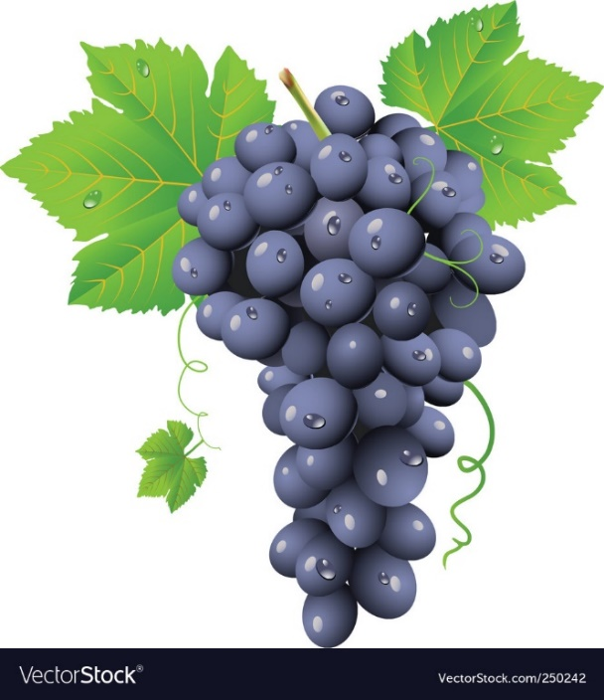
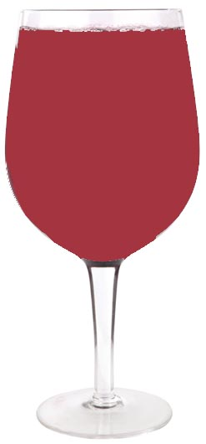
Wine in the Bible
Outline:
Archaeology & ancient literary sources
Old Testament passages
New Testament passages
Recreational drugs: Marijuana
Modern science and alcohol
Steven Rudd
March 2024
www.bible.ca

Slide 3
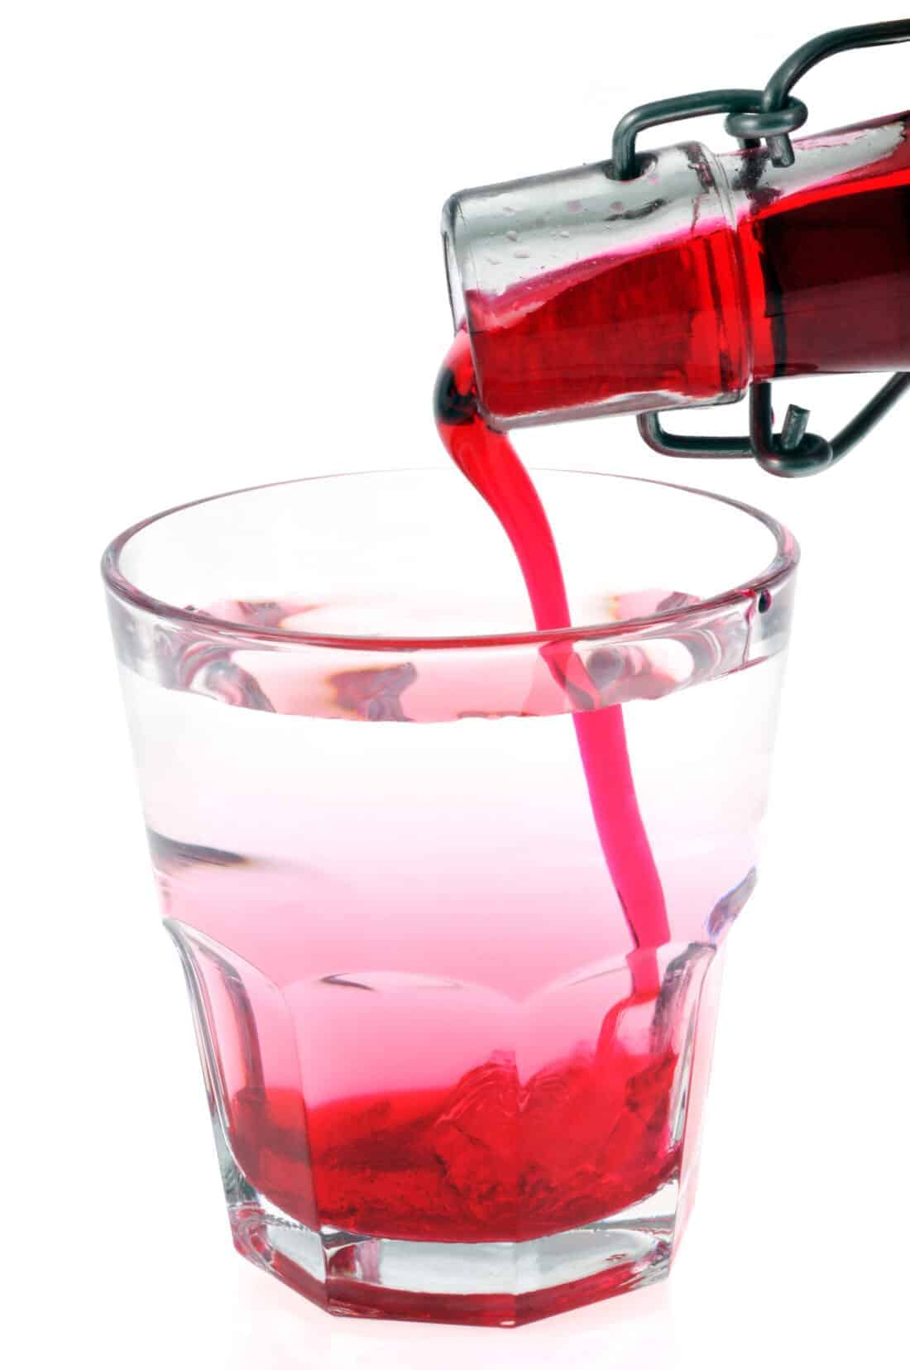
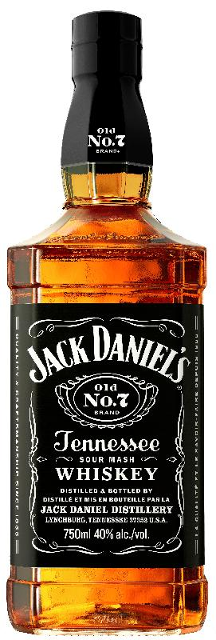
Wine in the Bible
“Oinos” default/popular usage, exceptions exist.
“Strong drink”
unmixed wine
6-8%
“Wine”
Water-mixed wine <2%
Raisin Wine 0%
“Fruit of Vine”
Grape Juice
Scotch, Whisky, Vodka
Not produced or consumed
No Bible reference
Not Biblical “strong drink”
40%
X
Steven Rudd March 2024, www.bible.ca

Slide 4
Wine in the Bible
First century Romans, Jews, and Greeks drank wine mixed with water of low alcohol content and unmixed wine was Biblical “strong drink”.
Strong Drink
Steven Rudd March 2024
www.bible.ca

Slide 6
Water-Mixed Wine
1 part wine + 3 parts water
Drinking 1 glass of wine = drinking 4 glasses mixed wine
1 glass = 4 glasses
=
8%
2% + 2% + 2% + 2%

Slide 7
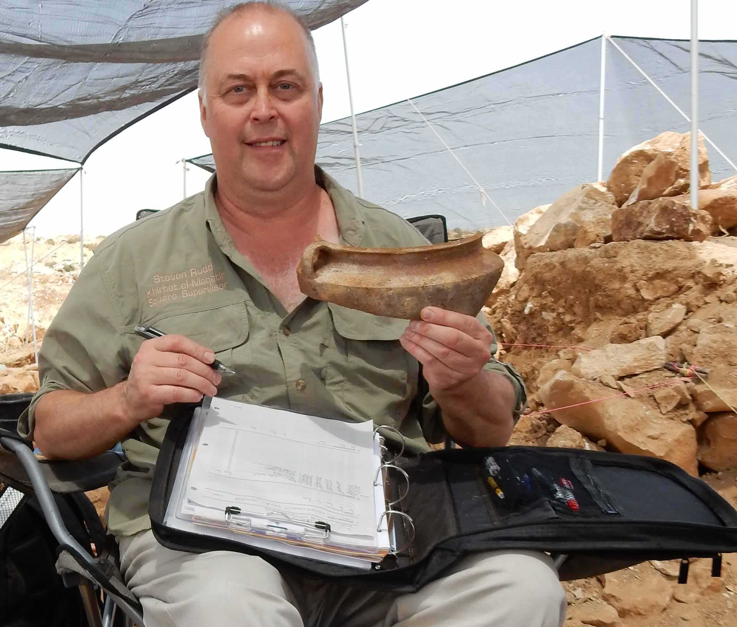
Wine in the Bible
Part 1: Archaeology and ancient literary sources

Slide 8
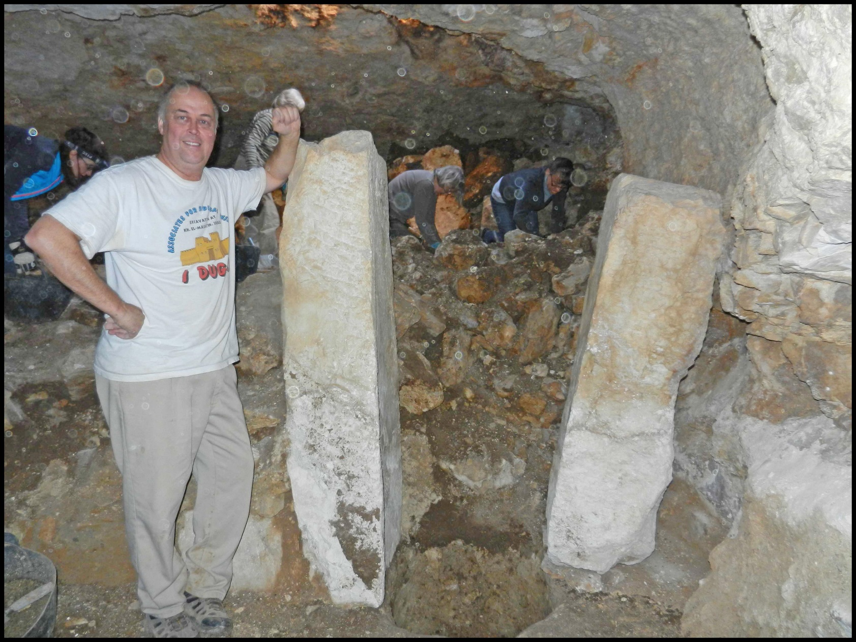
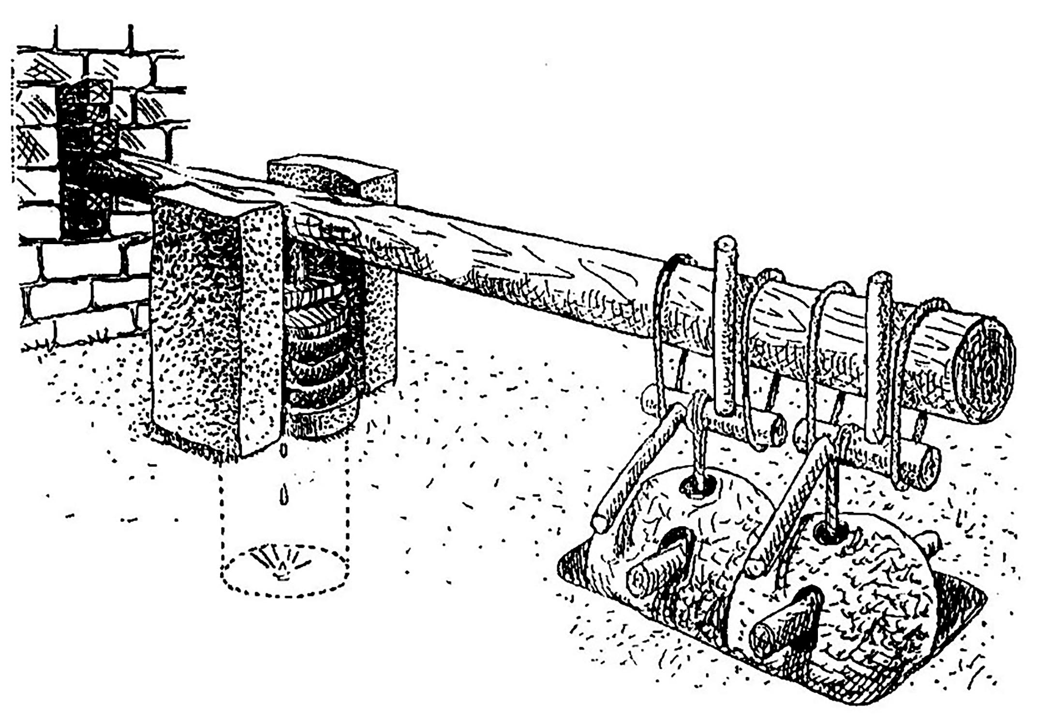
Jewish Wine Press, Kh. Maqatir, AD 67
Wine Press
Isa 5:2; Mt 21:33
Lever Wine Press
Cavern 1
Excavated by Steven Rudd
December 2013

Slide 9
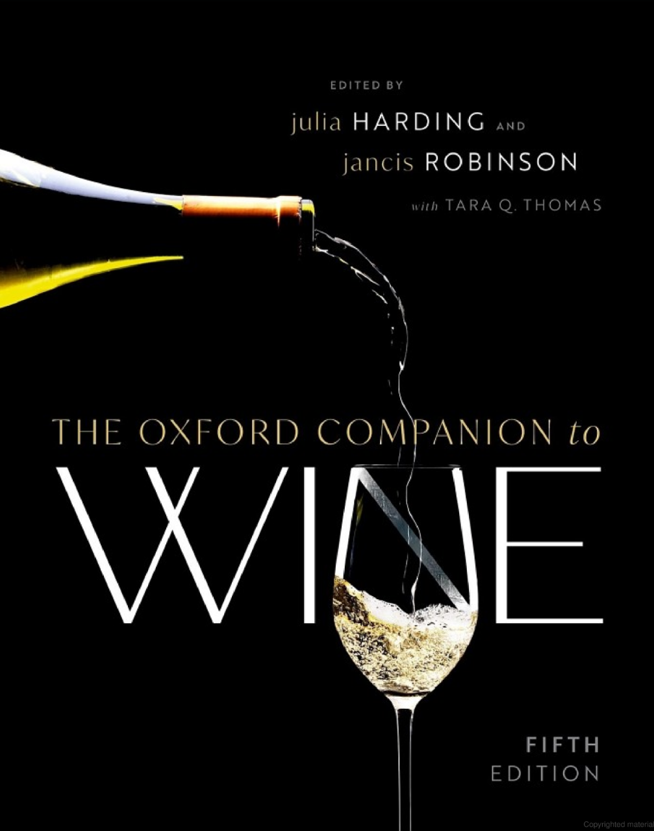
Deluted Wine in Ancient Greece and Rome:
“In Ancient Greece no civilized man would dream of drinking undiluted wine.”
“Wine was always diluted with water, indeed drinking undiluted wine was the mark of a barbarian in Ancient Greece and Ancient Rome”
(Oxford companion to wine, Jancis Robinson, p4, 810, 2015 AD)

Slide 10
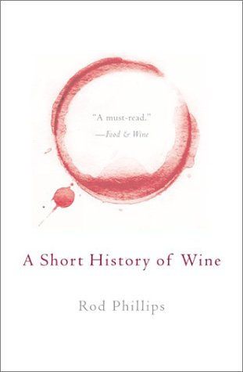
Deluted Wine and Beer in Ancient Greece:
“Drinking wine in the [Ancient] Greek manner was diluted, in good company and only to the stage of moderate intoxication as a sign of civilization. Drinking beer, undiluted wine, and drunkenness in general were, at best, signs of uncivilization, and at worst, outright barbarism”
(Rod Phillips, Shorty History of Wine, p80, 2002)

Slide 11
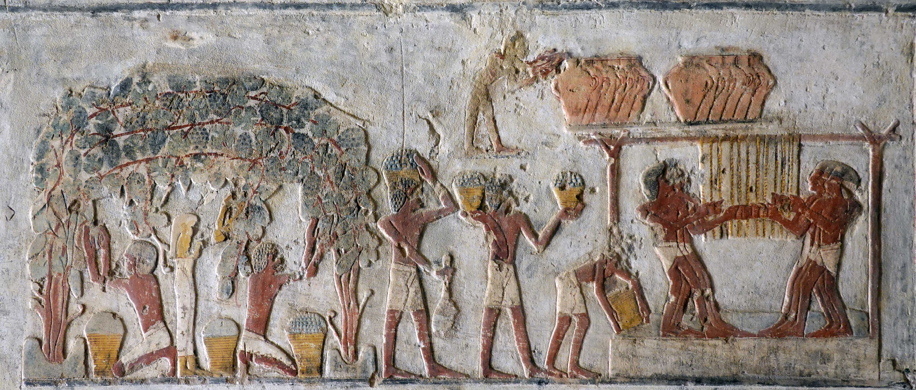
Tomb of Paheri at El Kab
Exodus era wine harvest: 1446 BC
Pharaoh of the exodus: Thutmoses III
18th dynasty

Slide 12
Tomb at El Kab of Paheri: c. Thutmoses III
Evidence of mixed wine: drunk = 18 cups
Nubmehy tells her servant: “Give me eighteen bowls of wine! See, I must like to drink until intoxicated. My insides are as dry as straw!”
Drunk today = 5 glasses @ 12%
Drunk = 18 Bowls of wine
Mixed wine during Exodus:
3 parts water, 1 part wine

Slide 13
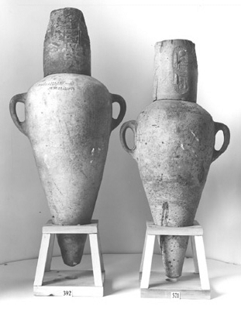
36 wine jars in the tomb of King Tut
18th Dynasty Pharaoh Tut'ankamun (1341-1331 BC)
In 1922, 36 sealed ceramic pithos jars holding wine were discovered in the tomb of Tut'ankamun (1341-1331 BC). Twenty-six of the jars bore seals from his 4th, 5th, and 9th regnal years.
One seal reads, “Year 4. Sweet wine of the House-of-Aton - Life, Prosperity, Health! - of the Western River. Chief vintner Aperershop”
Egyptians knew how to preserve wine for at least 5 years.

Slide 14
Ashurbanipal, king of Assyria 668-631 BC
Offering of beer & wine added to mortar of temple reno
“The temple of the god Nabû in Calah had become old. I removed its dilapidated section(s) and (then) I mixed beer and wine into mortar. Basket carriers made bricks while music, singing, happiness, and exultation, I built (and) completed (it) from its foundations to its peak. I roofed it with long beams of cedar. I decorated all its copings”
(Ashurbanipal 7, x 53')

Slide 15
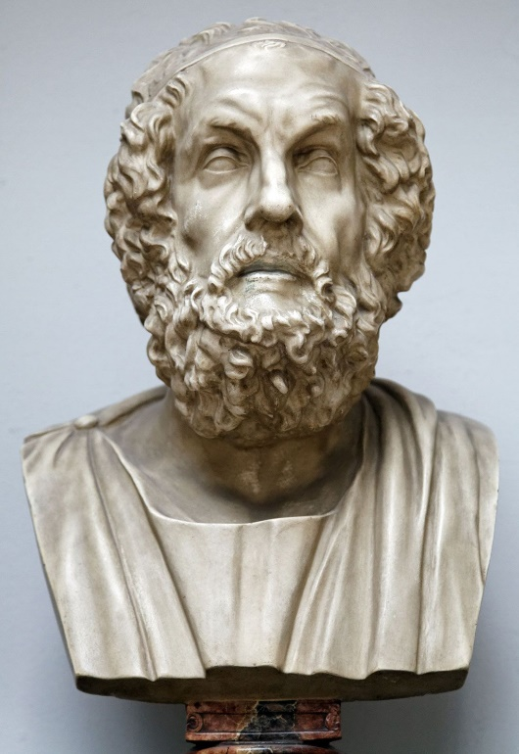
Homer: Wine mixed 20 to 1
“And he gave me splendid gifts of a silver mixing bowl and 12 jars filled with wine, wine sweet and unmixed, a drink divine. And as often as they drank that honey-sweet red wine he would fill 1 cup and pour it into 20 cups of water, and a smell would rise from the mixing-bowl marvelously sweet; then verily would one not choose to hold back. With this wine I filled and took with me a great skin.”
Homer, Odyssey 9.204, 700 BC

Slide 16
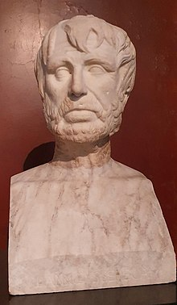
Hesoid: Wine mixed 3 to 1
“Let me drink bright wine, sitting in the shade, when my heart is satisfied with food, and so, turning my head to face the fresh Zephyr (wind), from the everflowing spring which pours down unfouled, three pours of an offering of water, but make a fourth libation of wine.
Hesoid, Works and Days 590, 700 BC

Slide 17
Raisin Wine: passum
Hebrews used raisins as food:
Num 6:3; 1 Sam 25:18, 2 Sam 16:1
Raisins were soaked in water and pressed to make non-alcoholic wine for daily consumption.
“The grapes are left on the vine to dry in the sun, or else are boiled in the pot (to create jelly paste). [Daily use:] They crush them and subject them to gentle pressure. They then draw off the juice and add to the pulp that is left an equal quantity of well-water until they swell.” (Pliny, Natural History, 14.11, 77 AD)
“Among the Romans, women are forbidden to drink wine; and they drink what is called passum, which is made from raisins, and tastes very like the sweet wine of Aegosthena or Crete.” (Polybius, Histories 39.19, 146 BC)
Mishnah and Talmud on Raisin wine:
“They do not bring wine from sun-dried grapes. And if they brought it, it is valid.” (Mishnah, Menahoth 8:6, 200 AD)
“The Mishnah has stated: They do not bring wine which derives from sun-dried grapes. And if they brought it from such a source, it is valid. (Babylonian Talmud, Menachot 9:6, 500 AD)

Slide 18
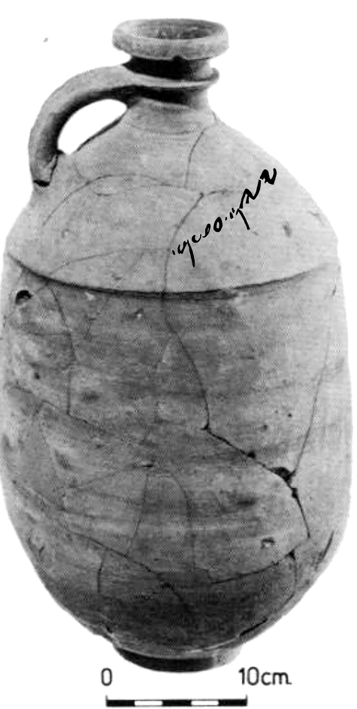
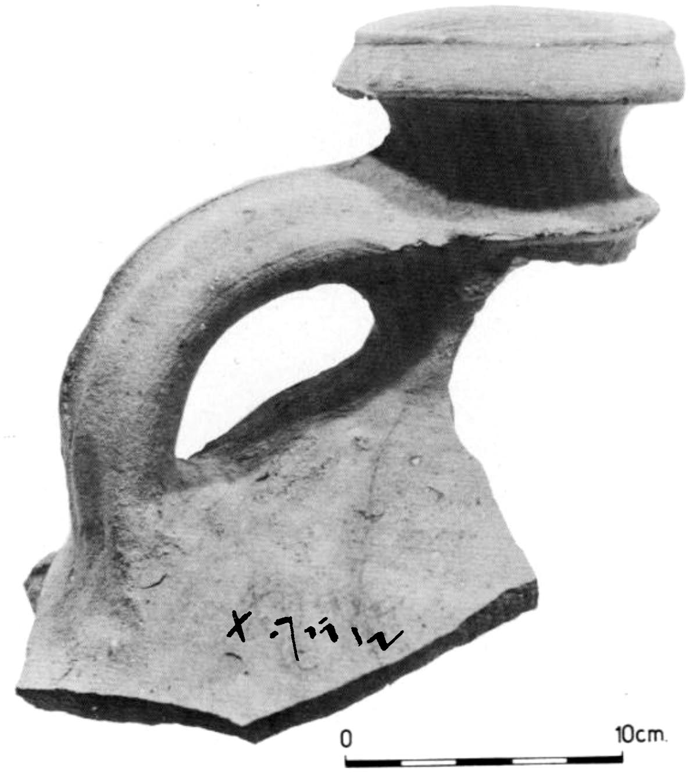
Lachish Raisin Wine: 587 BC
Num 6:3; 1 Sam 25:18, 2 Sam 16:1
Lachish inscription XXV on decanter
Reg. # 10881, Level II, 10.95 litres, 1977
“wine of Ashan”
2 Octraca
Excavations at Tel Lachish 1973-1977,
Preliminary Report, David Ussishkin
“wine of black raisins”
Lachish inscription XXX on decanter
Reg. #30696, Level II, room 4086, 1977

Slide 19
Maccabeus: Unmixed wine harmful
“It is hurtful to drink wine alone, but wine mixed with water is pleasant, and delightful to the taste.”
2 Maccabees 15:39, 160 BC
X
Judah Maccabeus triggered
the revolt in 167 BC when Antiochus IV ordered the Jews to sacrifice pigs in the temple and forbad circumcision. Pictured is his coin Steven Rudd excavated in 2012 AD
(Josephus Wars 1.34)

Slide 20
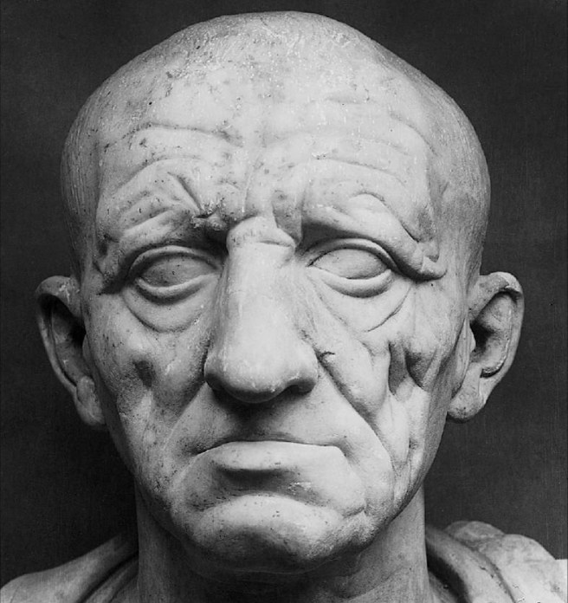
Marcus Cato: Stored wine mixed 5 to 1
Wine production 8 months storage
Wine + Water + Seawater + Vinegar (no yeast or sugar)
(Harvest: September. Solstice: June.)
“Wine to drink through the winter: Pour into a jar 10 amphora quadrantals (260 litres) of wine must, 2 quadrantals of sharp vinegar (52 litres), 2 quadrantals of boiled wine must (52 litres), 50 quadrantals of fresh water (1350 litres). Stir with a stick 3 times a day for 5 consecutive days. Then add 64 sextaruses of old sea-water (32 litres), cover the jar, and seal ten days later. This wine will last you until the summer solstice (Sept-June); whatever is left over after the solstice will be a very sharp and excellent vinegar.”
Marcus Cato the Elder, Agriculture 104, 150 BC

Slide 21
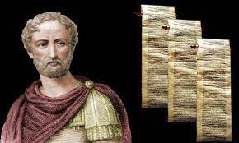
Mucianus: Wine mixed 8 to 1
“Gaius Licinius Mucianus, who held the Roman consulship three times (c. AD 66), and one of our most recent authors, when in the city of Maronea in Thrace, was witness himself to the fact that the custom was to mix 1 sextaius of this wine (1/2 litre) with no less than 8 sextariuses of water (4 litres).”
Pliny
History 14.6, AD 77

Slide 22
Plutarch: Wine mixed 3 to 1
“The proportion of 3 parts of water poured into 1 of wine is fit for magistrates sitting in the court, or for lawyers evaluating their arguments; for surely it is a mixture sober and weak enough. The proportion of 2 for 1 causes that turbulent tone of those who are half-drunk.”
Plutarch, QC 3.9.1, 100 AD

Slide 23
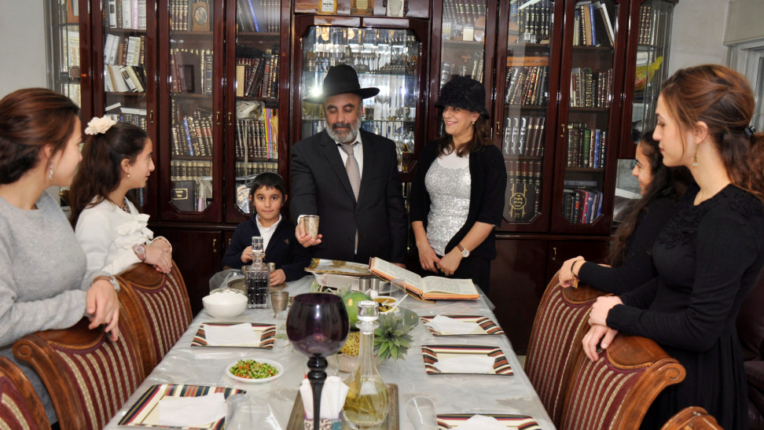
Mishnah: Unmixed wine forbidden
“Do not recite the prayer blessing over wine until one puts water into it so that it may be drunk.”
(Mishnah, Berakhot 7:5, AD 200)

Slide 24
Talmud: wine mixed minimum of 3 to 1
“Strong drink” was unmixed wine
“Wine” was wine mixed 3 to 1
“Wine that cannot be mixed with at least 3 parts of water to 1 part of wine is not wine.”
Babylonian Talmud,
Sabbath 77a, AD 500

Slide 25
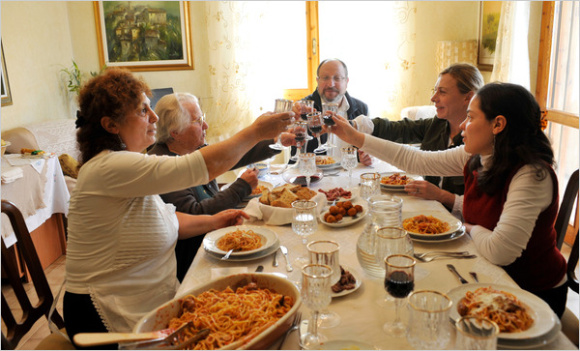
Europeans routinely diluted their wine with water until the 1980’s, in part, as the result of a clean water supply, but then they drank less wine. Drinking undiluted wine is a very recent social development and is “strong drink” of the Bible.
Source:
Tradition of Mixing Wine With Water in Italy, Spain and France. Circumstances of Appearance and Reasons for Disappearance, Natalia Kirillovna Bronnikova, p168, 2019 AD

Slide 26
Alcohol content:
Modern wine: 12%
Sugar or yeast added
Fermentation maximized
Ancient wine: 8%
No sugar or yeast added
Fermentation minimized
Dinner table wine:
1:20 of 8% = 0.4%
1:8 of 8% = 0.9%
1:3 of 8% = 2%
Notes:
Moderate-Alcohol Wines: 12.5%-14% ABV. Unless you weigh 250 lbs or more, two glasses of wine in an hour makes you legally drunk. [40 diluted glasses required; 20 to 30 times more alchol.]
Fortified wine has a much higher alcohol content than regular varieties. Due to the addition of distilled spirits, such as brandy, fortified wines can contain 17–20% alcohol, …
https://www.healthline.com › nutrition › fortified-wine

Slide 27
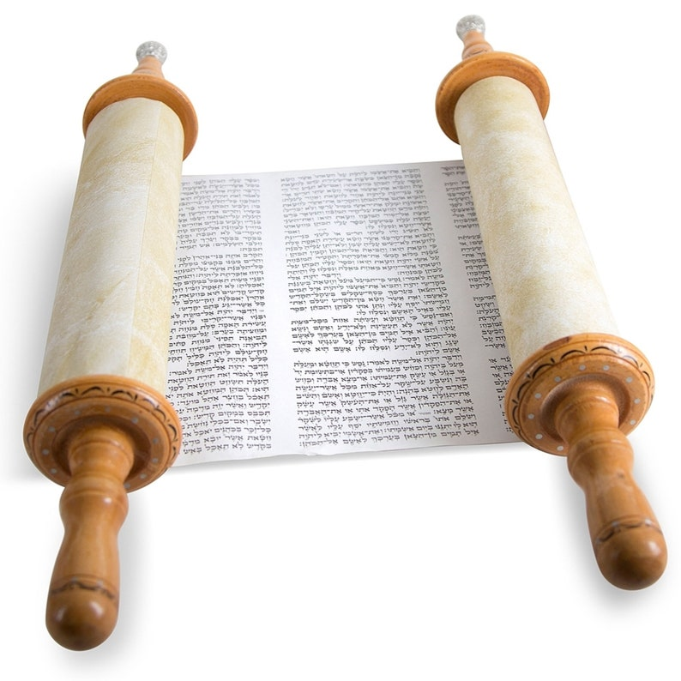
Wine in the Bible
Part 2: Old Testament Texts

Slide 28
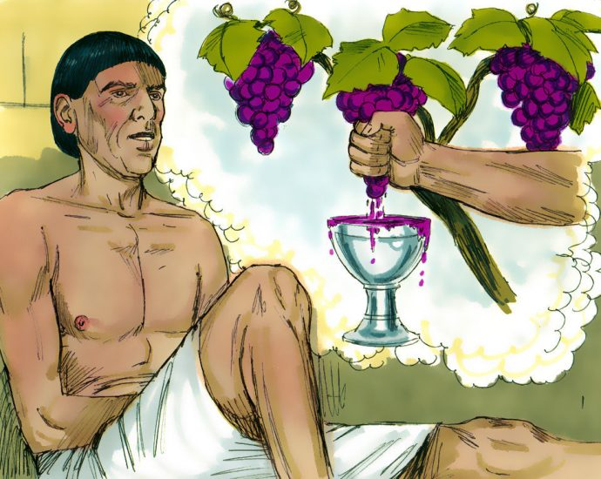
Joseph’s cupbearer served grape juice
“In my dream, behold, there was a vine in front of me; and on the vine were three branches. And as it was budding, its blossoms came out, and its clusters produced ripe grapes. “Now Pharaoh’s cup was in my hand; so I took the grapes and squeezed them into Pharaoh’s cup [when he had strained the wine], and I put the cup into Pharaoh’s hand.”
Gen 40:9–11
Josephus Ant. 2.64
1888 BC
Sesostris I (1918-1874 BC)
12th Dynasty Egypt

Slide 29
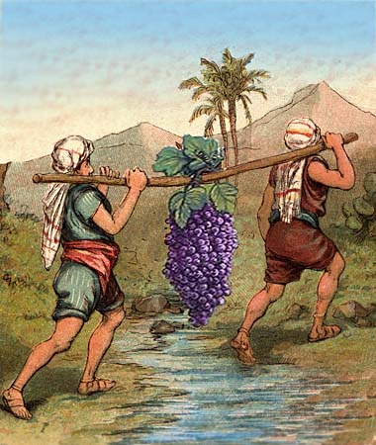
Israel Drank Wine mixed with water
“Eat your bread in happiness and drink your [mixed] wine with a cheerful heart, for God has already approved your works." (Ecclesiastes 9:7)
Joshua brought back a large cluster of grapes from promised land as evidence it flowed with milk, honey, and wine.

Slide 30
“She (wisdom) has prepared her food, she has mixed her wine; She has also set her table. … Come, eat of my food and drink of the wine I have mixed.” (Prov 9:2,5)
“You may spend the money for whatever your heart desires: for oxen, or sheep, or [mixed] wine, or strong drink [unmixed wine], or whatever your heart desires. (Deut 14:26)
Wine was added to a glass of water
Unmixed wine was commonly purchased by Jews as a standard grocery item which they would mix with water just before serve time at the dinner table.

Slide 31
“Strong drink” was unmixed wine
“Wine” was
mixed wine
“Your navel is like a round goblet which never lacks mixed wine.” (SOS 7:2)

Slide 32
“Strong drink” was unmixed wine
“Wine” was
mixed wine
“Nazirite shall abstain from wine and strong drink; he shall drink no vinegar, whether made from wine or strong drink,
nor shall he drink any grape juice
nor eat fresh or dried grapes.”
(Numbers 6:2–3)

Slide 33
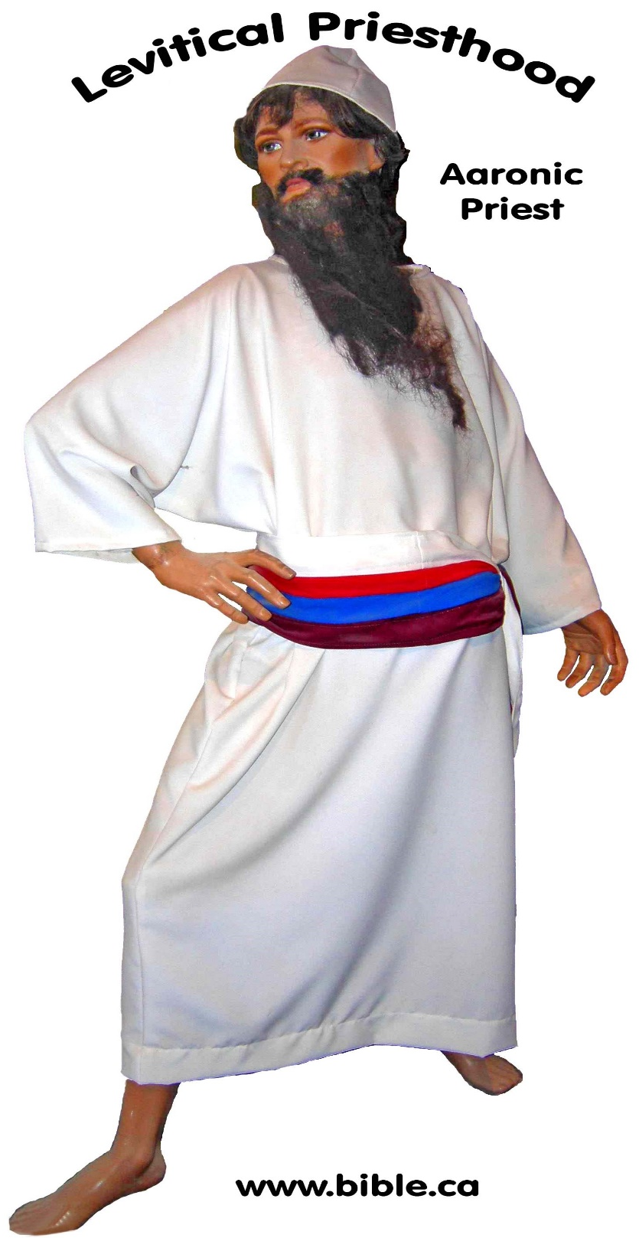
“Strong drink” was unmixed wine
"YHWH spoke to Aaron, saying, “Do not drink wine or strong drink, neither you nor your sons with you, when you come into the tent of meeting, so that you will not die—it is a perpetual statute throughout your generations—" (Lev 10:8–9)
Levites forbidden to drink wine before service.
Christians are perpetual priests in God’s temple

Slide 34
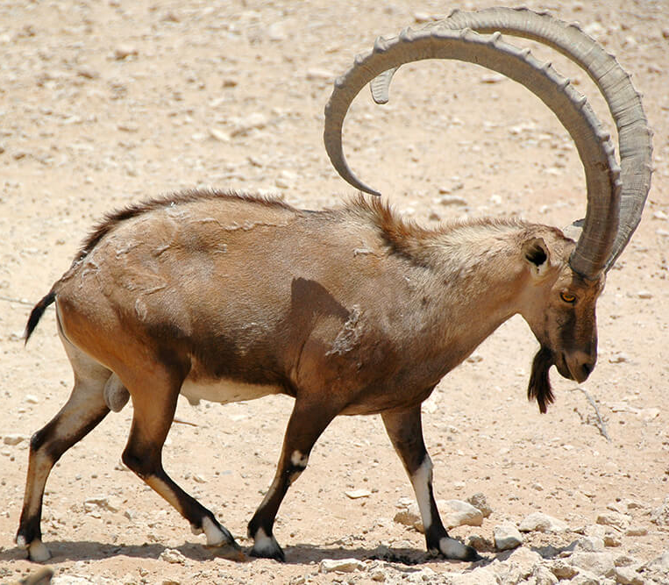
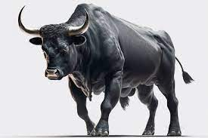
Sacrificial offerings of common foods:
Lamb, ram, bull, grain, olive oil, wine
All sacrificed included wine:
Grain offering with 1 litre of wine: Lev 23:13
Males only + Bread (Flower + Oil) + Wine
Burnt Lamb offering with 1 litre of wine: Num 15:4-5
Burnt Ram offering with 1.5 litres of wine: Num 15:6-7
Burnt Bull offering with 2 litres of wine: Num 15:8-10
1L 1.5L 2L
Notes:
Moderate-Alcohol Wines: 12.5%-14% ABV. Unless you weigh 250 lbs or more, two glasses of wine in an hour makes you legally drunk. [40 diluted glasses required; 20 to 30 times more alchol.]
Fortified wine has a much higher alcohol content than regular varieties. Due to the addition of distilled spirits, such as brandy, fortified wines can contain 17–20% alcohol, …
https://www.healthline.com › nutrition › fortified-wine

Slide 35
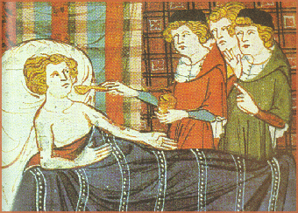
“It is not for [righteous] kings to drink wine or desire strong drink… Give strong drink to the perishing [i.e. wicked or terminally ill], and wine to him whose is bitter of soul. Let him drink and forget his poverty [doom or death] and remember his trouble no more.” (Prov 31:4–7)
OR
Relief for the dying
Bridge to hell for wicked

Slide 36
“Wine is a mocker, strong drink a brawler, and whoever is intoxicated by it is not wise.” (Prov 20:1)

Slide 37
730 BC: 3 readings from Isa 5 are like today’s woke world.
“Woe to those who call evil good, and good evil; Who substitute darkness for light and light for darkness.” (Isaiah 5:20)
“Woe to those who rise early in the morning that they may pursue strong drink, who stay up late in the evening that wine may inflame them! Their banquets are accompanied by lyre and harp, by tambourine and flute, and by wine and they ignore God.”
(Isa 5:11) 730 BC

Slide 38
“Woe to those who are heroes in drinking wine and valiant men in mixing strong drink” (Isa 5:22)
“Come, let us get wine, and let us drink heavily of strong drink; and tomorrow will be like today, only more so.” (Isa 56:12)
Role model Taylor Swift chugs a beer at Superbowl LVIII
and slams it on the table like a hero.

Slide 39
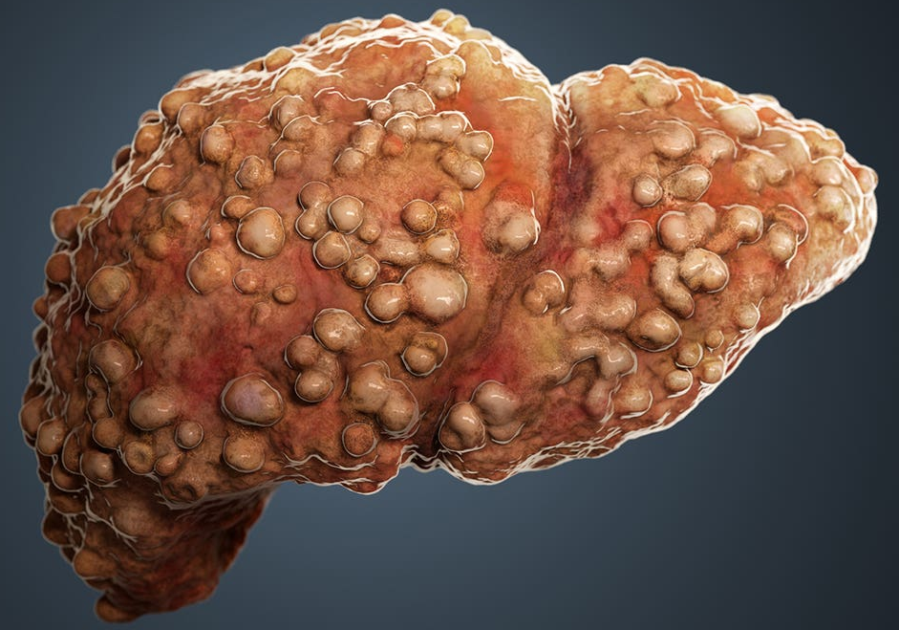
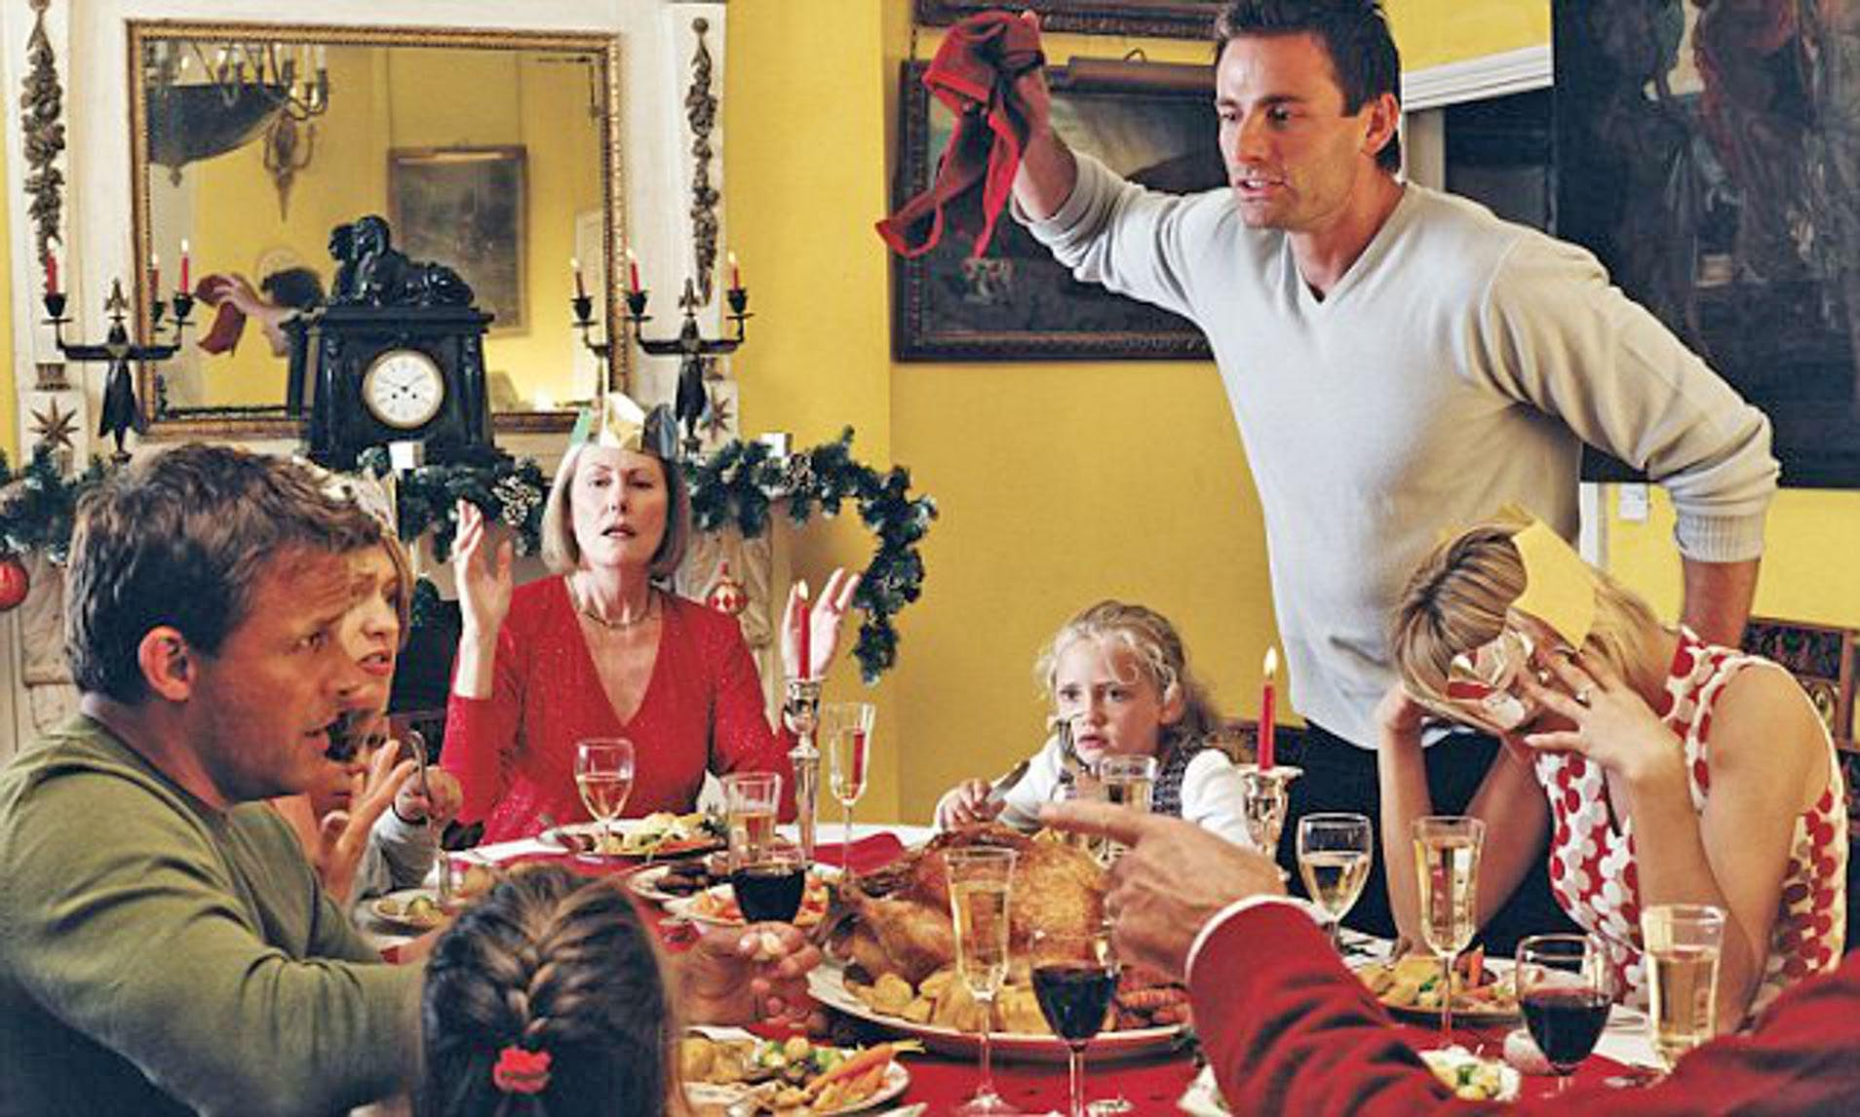
“The wicked drink the wine of violence.”
(Prov 4:17)
“Who has woe, sorrow, contentions, complaining, wounds without cause and red eyes? Those who drink wine.” (Prov 23:29)
Liver Cirrhosis
Divorce
Abuse
Single
mothers
Festive-time Strife
Death

Slide 40
MADD: Mothers against Drunk Drivers
FADP: Fathers Against Drunk Pedestrians

Slide 41
Wine in the Bible
Part 3: New Testament Texts

Slide 42
Water-mixed Wine at Cana
“Strong drink” was unmixed wine
“Wine” was water-mixed wine
John 2:6
180 gallons of water in 6 stone pots infers it was water mixed with high quality wine. The headwaiter would have rejected unmixed wine because nobody would drink it.
“My abode was in a village of Galilee, which is named Cana.”
(Josephus, Life 86, AD 66)

Slide 44
63 BC – AD 70
Excavated by Steven Rudd
December 2013
Cana

Slide 45
Christians use “fruit of vine” in Communion
“I will not drink of this fruit of the vine from now on until that day when I drink it new with you in My Father’s kingdom.” (Mt 26:29; Mk 14:25; Lk 22:18)
Unleavened Bread and Unleavened grape juice/raisin wine
“You shall not offer the blood of My sacrifice with leavened bread.” (Exodus 23:18)
Jews in 419 BC used unleavened grape juice in the Passover meal, just as Jesus did in AD 33.

Slide 46
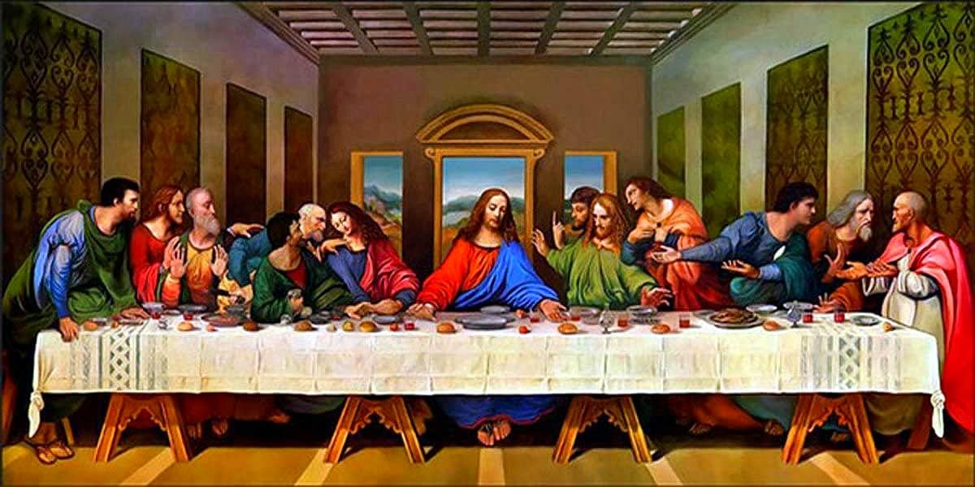
Christ used “fruit of vine” in Communion
Christ used raisin wine or mixed wine at the last supper without leaven or yeast, as per Passover law. Ancient winemaking often excluded all sugar and yeast, so most ancient wines were Passover approved.
Today’s wines would never make it onto Jesus’ Passover supper when he instituted communion, not only because unmixed wines were considered “strong drink”, but because of the yeast content which violated Ex 12.
Fruit of the vine:
Raisin wine was likely used at the last supper with no yeast and 0% alcohol

Slide 47
Timothy was an abstainer
“No longer drink water exclusively but use a little wine medicinally for the sake of your stomach and your frequent ailments.”
(1 Tim 5:23)
“Milk strengthens the bones… wine in moderation strengthens the sinews… wine refreshes the stomach.” (Pliny, Natural History, 23.22, 77 AD)
“Wine is the most beneficial of all drinks, the pleasantest medicine in the world, when properly mixed with water.” (Plutarch, De tuenda 19, 100 AD)
“Wine is the first weapon used by demons against the young and kindles the fire of sexual pleasure. Notice the reasons for which the permission is given to drink wine, to cure an aching stomach and a frequent infirmity.” (Jerome, Letter 22.8, comment on 1 Tim 5:23, 400 AD)

Slide 48
Elders not addicted to wine
“An overseer, then, must be above reproach, the husband of one wife, temperate, prudent, respectable, hospitable, able to teach, not a drunk or violent, but gentle, peaceable, free from the love of money.” (1 Timothy 3:2–3)
Drank mixed wine, never drunk

Slide 49
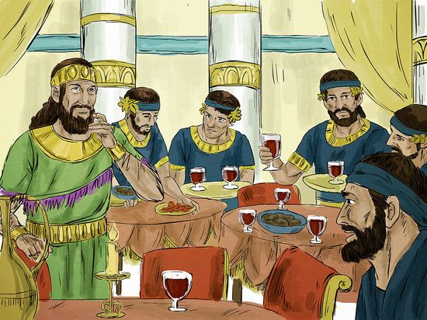
Jesus attended Matthew’s mixed wine reception
Jesus likened himself to new wine
“And Levi gave a big reception for Jesus in his house; and there was a great crowd of tax collectors and other people who were reclining at the table with them. The Pharisees and scribes grumbled, “Why do you eat and drink [mixed wine] with the tax collectors and sinners?” … Jesus replied, No one puts new wine into old wineskins; the new wine will burst the skins and it will be spilled out, and the skins will be ruined. But new wine must be put into fresh wineskins. And no one, after drinking old wine wishes for new; but says, ‘The old is good enough.” (Lk 5:29–39)

Slide 50
Jesus attended Matthew’s mixed wine reception
Proverbs of the day:
“Do not forsake an old friend, for the new friend is not equal to him. A new friend is new wine; if it ages, you will drink it with joy.” (Sirach 9:10)
“He who learns from children is like one who eats sour grapes and drinks fresh wine. “And he who learns from old men is like he who eats ripe grapes and drinks vintage/old wine.”
(Mishnah, Pirke Aboth 4.20, 200 AD)
Jesus likened himself to new wine
“Old is better” is why the Jews rejected of Jesus, and Jesus through irony, cleverly refutes the common proverbs and proposes the opposite meaning. Jesus was the new wine which the Jews rejected outright. Old is not always better, just as the Jesus’ way and Law of Christ is better than the John’s way and the old Law of Moses.

Slide 51
Drunk 3rd hour of the day
Acts 2:17 “They are drunk on grape juice”
Mocking
Sweet wine was freshly squeezed grape juice
Drunk on non-alcoholic grape juice was a deliberate mockery
Peter asked them to make a value judgment:
“Only worthless barbarians are drunk
in the morning.”
“Do we look like alcoholics?”

Slide 52
“You have already spent enough time living like a non-Christian with sensuality, lusts, drunkenness, carousing, drinking parties and lawless idolatries. Your friends are surprised that you refuse to party with them anymore and they trash-talk you behind your back. (1 Peter 4:3–5)
Beer Pong
Drinking
Game

Slide 53
Symposia idolatrous drinking parties
1 Peter 4:3: Greek symposia were wild drinking parties hosted in private homes with up to 20 men reclining on boxes who toasted the god Dionysus with water-mixed wine.
“drinking parties and abominable idolatries”
(1 Pe 4:3)

Slide 54
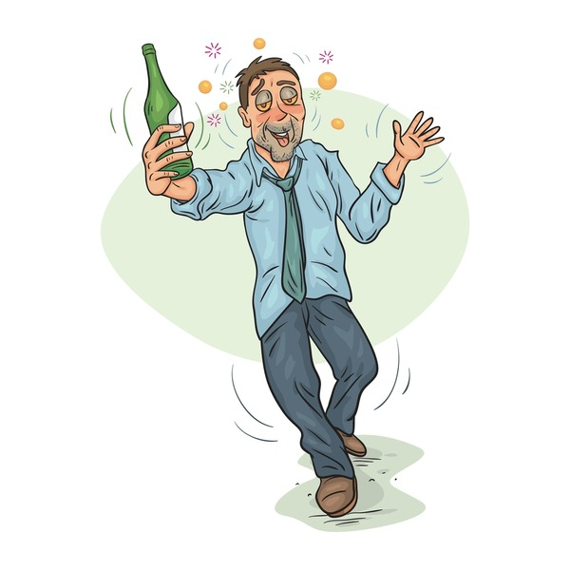
“The deeds of the flesh are evident, drunkenness and carousing, and things like these, of which I forewarn you that those who practice such things will not inherit the kingdom of God.” (Gal 5:19)
“Do not be deceived, drunkards will not inherit the kingdom of God. Such were some of you; but you were washed, sanctified, justified in the name of Jesus.” (1 Cor 6:9)

Slide 55
“Let us behave properly as in the day, not in carousing and drunkenness, not in sexual promiscuity and sensuality, not in strife and jealousy. But put on the Lord Jesus Christ, and make no provision for the flesh in regard to its lusts.”
(Romans 13:13–14)

Slide 56
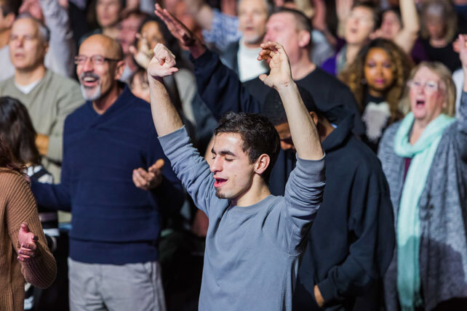
“Do not get drunk with wine spirits, singing carnal songs, for that is debauchery.
Instead, be filled with the Holy Spirit with psalms, hymns, and spiritual songs”. (Eph 5:18)

Slide 57
The wicked drink unmixed wine:
“If anyone worships the beast and receives a mark on his forehead or on his hand, he also will drink of the wine of the wrath of God, which is unmixed in full strength in the cup of His anger; and he will be tormented with fire and brimstone." (Rev 14:9)

Slide 58
Seven Bible Examples of Drunkenness
that resulted death and destruction
Noah: Caanan eternally cursed: Gen 9:21-25; Neh 9:24
Lot: Incestuous origin of Moab and Ammon who became the enemies of Jews: Gen 19:32–38; Zeph 2:9
Nadab and Abihu: Killed for offering strange fire while drunk: Lev 10:1-11
Nabal: Turned David away during a drunken feast day of sheep shearing: 1 Samuel 25:8,11,36-38
Amnon: Executed while drunk for raping Tamar, the sister of Absalom: 2 Samuel 13:28
Belshazzar: Died and Babylonian kingdom defeated by Persians in 539 BC: Dan 5:4
Harlot: Was drunk when she killed Christians: Rev 17:2-6

Slide 59
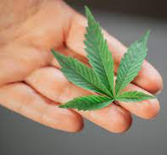
Wine in the Bible
Part 4: Marijuana and recreational drugs

Slide 60
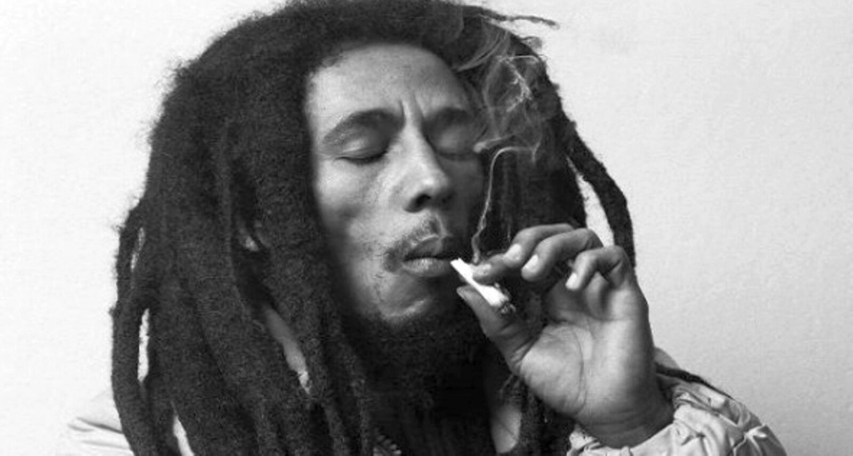
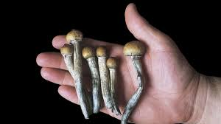
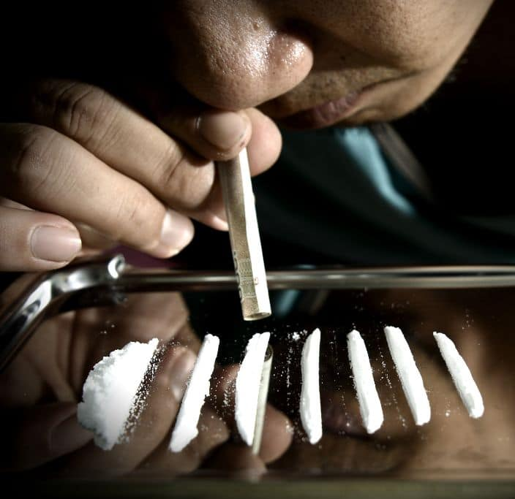
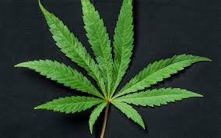
Mind Altering Drugs:
Recreational drugs like Marijuana are condemned without a prescription from a doctor.
Right now, Bob Marley wishes he
had spent more time in church
and less time smoking pot.
“The deeds of the flesh are evident, sorcery [pharakeia = pharmacy = drugs] of which I forewarn you that those who practice such things will not inherit the kingdom of God.” (Gal 5:19)

Slide 61
Wine in the Bible
Part 5: Modern Science

Slide 62
“A glass a day keeps
the doctor away.”

Slide 63
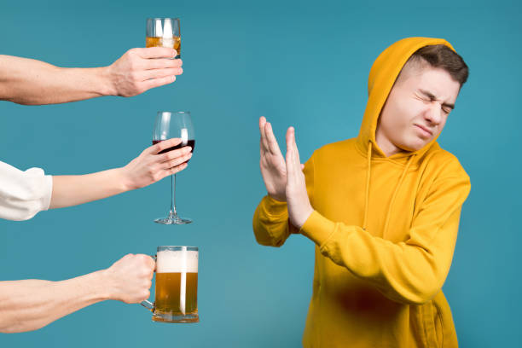
“The health risks associated with alcohol are massive… Zero alcohol consumption minimizes the overall risk of health loss. …The myth that one or two drinks a day are good for you is just that -- a myth. …
This study shatters that myth.”
August 24, 2018

Slide 64
“A new scientific study concludes there
is no safe level of drinking alcohol.”
“The study, published today in the international medical journal The Lancet, shows that in 2016, nearly 3 million deaths globally were attributed to alcohol use…”
August 24, 2018
August 24, 2018

Slide 65
“With the largest collected evidence base to date… (more than 40 nations contributed to the study) we now understand that alcohol is one of the major causes of death in the world today," said Lancet Editor…”
Liver Cirrhosis
August 24, 2018

Slide 66
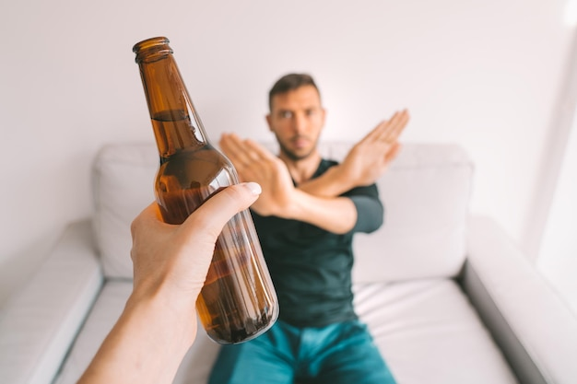
Canada’s Guidance on Alcohol and Health: 2023
“For your health, less alcohol is better.”
“0 drinks per week — Not drinking has benefits, such as better health, and better sleep.”
Publication date: 2023

Slide 67
Irony
“The sons of darkness are wiser than the sons of light.” (Luke 16:8)
World: Be an abstainer
Church: Social drinking is ok as long as you don’t get drunk

Slide 68
Conclusions
Wine in the Bible:
Strong drink is unmixed wine, not whisky, vodka etc.
Biblical wines were 8% alcohol, modern are 12%.
Modern wine and beer are biblically “strong drink”.
“Wine” generally means “wine mixed with water” .
Water to wine ratios were never less than 3:1 with no more than 2% alcohol levels.
Its ok to buy modern wines and beers if mixed with water.
Only barbarians and alcoholics drank unmixed wine.
Winemaking ingredients did not add sugar or yeast with a goal to minimizing fermentation and alcohol levels.
Non-alcoholic wines made from raisins and grape jelly were widely available as preferred drinks.
Fruit of the vine used in communion, was often a non-alcoholic wine made daily from water-soaked raisins.
Modern science recommends zero alcohol consumption.
The Christian ideal is to be an abstainer from alcohol.

Slide 69
Wine in the Bible
Part 6: Time for you to chose
“The bottle is in your court”
Which will you choose?
Strong Drink
?

Slide 70
Abstain from Alcohol!
Steven Rudd March 2024
www.bible.ca

Slide 71
YouTube
https://youtu.be/NkKzlxdIxS8
PowerPoint
www.bible.ca/rudd/wine.pptx
Steven Rudd
905-541-1534
Steve.Rudd@Bible.ca

