Slide 1
In the Same Hour
A Study Guide in Personal Evangelism
Charles G. Goodall
Graphics by Kevin Maxey
Digitized by Steven Rudd on Bible.ca
of the Night

Slide 2
Isaiah 2:2-3
2 Now it shall come to pass in the latter days that the mountain of the Lord’s house shall be established on the top of the mountains, and shall be exalted above the hills; and all nations shall flow to it.
3 Many people shall come and say, “Come, let us go up to the mountain of the Lord, to the house of Jacob; He will teach us His ways, and we shall walk in His paths.” For out of Zion shall go forth the law, and the word of the Lord from Jerusalem.
OT PROPHECY

Slide 3
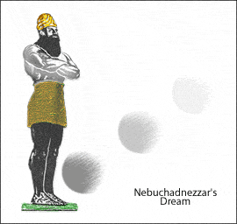
Daniel 2:44
Babylon Gold
Medo-Persia Silver
Greece Bronze
Rome Iron
God’s Kingdom Stone
44 And in the days of these kings the God of heaven shall set up a kingdom which shall never be destroyed; and the kingdom shall not be left to other people; it shall break and consume all these kingdoms, and it shall stand forever.
OT PROPHECY

Slide 4
Joel 2:28,32
28 "And it shall come to pass afterward that I will pour out My Spirit on all flesh; Your sons and your daughters shall prophesy, your old men shall dream dreams, your young men shall see visions.
32 And it shall come to pass that whoever calls on the name of the Lord shall be saved. For in Mount Zion and in Jerusalem there shall be deliverance, as the Lord has said, among the remnant whom the Lord calls.
OT PROPHECY

Slide 5
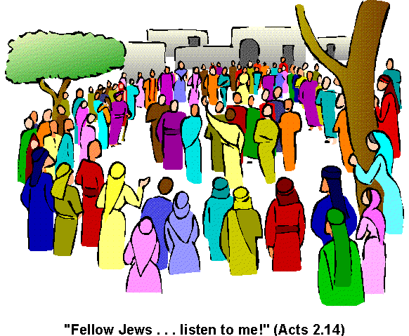
Isaiah 62:2
2 And the Gentiles shall see your righteousness, and all kings your glory. You shall be called by a new name, which the mouth of the Lord will name
OT PROPHECY

Slide 6
Jeremiah 31:31-32
31 Behold, the days are coming, says the Lord, when I will make a new covenant with the house of Israel and with the house of Judah, 32 not according to the covenant that I made with their fathers in the day
that I took them by the hand to lead them out of the land of Egypt, My covenant which they broke, though I was a husband to them, says the Lord.
OT PROPHECY

Slide 7
Prophecy & Establishment of the
OT Prophecy
Isaiah 2:2-3 Latter days Lord’s house established Law go forth from Jerusalem
Daniel 2:44 Days - These Kings Everlasting Kingdom
Joel 2:28-32 Pour Out Spirit Jerusalem Whoever call - saved
Isaiah 62:2 New Name
Jeremiah 31:31-32 New Covenant
When Were
These Fulfilled?
CHURCH

Slide 8
Matthew 3:1-3
1 In those days John the Baptist came preaching in the wilderness of Judea, 2 and saying, “Repent for the kingdom of heaven is at hand!”
3 For this is he who was spoken of by the prophet Isaiah, saying: "The voice of one crying in the wilderness: 'Prepare the way of the Lord; Make His paths straight.'
NT GOSPELS

Slide 9
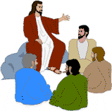
Matthew 4:17
17 From that time Jesus began to preach and to say, “Repent for the kingdom of heaven is at hand.”
NT GOSPELS

Slide 10
Matthew 16:13-19
13 When Jesus came into the region of Caesarea Philippi, He asked His disciples, saying, "Who do men say that I, the Son of Man, am?"14 So they said, "Some say John the Baptist, some Elijah, and others Jeremiah or one of the prophets."15 He said to them, "But who do you say that I am?"16 Simon Peter answered and said, "You are the Christ, the Son of the living God.“ 17 Jesus answered and said to him, “Blessed are you, Simon
Bar-Jonah, for flesh and blood has not revealed this to you, but My Father who is in heaven. 18 And I also say to you that you are Peter, and on this rock I will build My church, and the gates of Hades shall not prevail against it. 19 And I will give you the keys of the kingdom of heaven, and whatever you bind on earth will be bound in heaven, and whatever you loose on earth will be loosed in heaven."
NT GOSPELS

Slide 11
Mark 9:1
1 And He said to them, “Assuredly, I say to you that there are some standing here who will not taste death till they see the kingdom of God present with power.”
NT GOSPELS

Slide 12
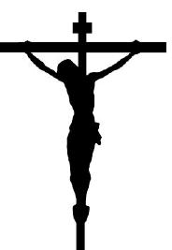
Prophecy & Establishment of the
OT Prophecy
Isaiah 2:2-3 Latter days Lord’s house established Law go forth from Jerusalem
Daniel 2:44 Days - These Kings Everlasting Kingdom
Joel 2:28-32 Pour Out Spirit Jerusalem Whoever call - saved
Isaiah 62:2 New Name
Jeremiah 31:31-32 New Covenant
Gospels
Matt. 3:1-3 John the baptizer Crying in wilderness Prepares way for Jesus Repent Kingdom at hand
Matthew 4:17 Jesus identified Repent Kingdom at hand
Matthew 16:18-19 I will build My church Church and kingdom are the same
Mark 9:1 Kingdom coming with power in that generation
Mark 15:16-20; 16:1f Jesus is crucified Jesus is risen on the 3rd day
What
Next?
CHURCH

Slide 13
Arrival of the Day of
Jesus is arrested (John 18:36)
Jesus died on the cross (Luke 23:33)
Jesus rose (Luke 24:1-7)
Jesus appeared 40 days teaching
about the kingdom (Acts 1:3)
Jesus ascends (Acts 1:9-11)
Holy Spirit comes on the day of
Pentecost (Acts 2:1-13)
Peter’s sermon (Acts 2:14-39)
    The fulfillment of prophecy
    The chilling indictment
PENTECOST

Slide 14
When Did it Come?
Kingdom → Power (Mark 9:1)
Power → Holy Spirit (Acts 1:8)
Holy Spirit → Pentecost (Acts 2:1-4)
The kingdom came on Pentecost!
(Col. 1:13)
KINGDOM

Slide 15
Prophecy & Establishment of the
OT Prophecy
Isaiah 2:2-3 Latter days Lord’s house established Law go forth from Jerusalem
Daniel 2:44 Days - These Kings Everlasting Kingdom
Joel 2:28-32 Pour Out Spirit Jerusalem Whoever call - saved
Isaiah 62:2 New Name
Jeremiah 31:31-32 New Covenant
Gospels
Jo. 3:1-6; Matt. 3:1-3 John the baptizer Crying in wilderness Prepares way for Jesus Repent Kingdom at hand
Matthew 4:17 Jesus identified Repent Kingdom at hand
Matthew 16:18-19 I will build My church Church and kingdom are the same
Mark 9:1 Kingdom coming with power in that generation
Mark 15:16-20; 16:1f Jesus is crucified Jesus is risen on the 3rd day
Pentecost
Acts 1:3 Jesus speaking about the Kingdom
Acts 1:4-8 Apostles Stay in Jerusalem Receive power when Holy Spirit comes
Acts 2:1-4 Day of Pentecost Jerusalem Apostles Receive Holy Spirit
Acts 2:16 Peter preaches “This is that” What Joel spoke
Acts 2:36-47 Salvation Repent & Baptized Believed Lord added saved to His one church
CHURCH

Slide 16
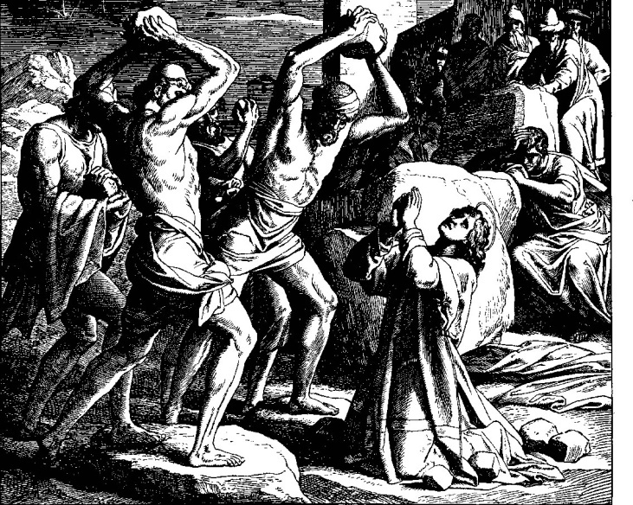
Acts 8:1
1 Now Saul was consenting to his death. At that time a great persecution arose against the church which was at Jerusalem; and they were all scattered throughout the regions of Judea and Samaria, except the apostles
AFTER PENT

Slide 17
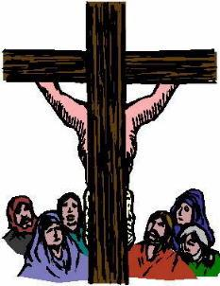
Colossians 1:13-14
13 He has delivered us from the power of darkness and conveyed us into the kingdom of the Son of His love 14 in whom we have redemption through His blood, the forgiveness of sins
AFTER PENT

Slide 18
Prophecy & Establishment of the
OT Prophesy
Isaiah 2:2-3 Latter days Lord’s house established Law from Jerusalem
Daniel 2:44 Days-These Kings Everlasting Kingdom
Joel 2:28-32 Pour Out Spirit Jerusalem Whoever call - saved
Isaiah 62:2 New Name
Jer. 31:31-32 New Covenant
Gospels
Jo.3:1f; Mt.3:1f John the baptizer Crying in wilderness Prepares way for Jesus Repent Kingdom at hand
Matt. 4:17 Jesus identified Repent Kingdom at hand
Matt. 16:18-19 I will build My church Church and kingdom are the same
Mark 9:1 Kingdom coming with power in that generation
Mk15:16-20; 16:1f Jesus is crucified Jesus is risen on the 3rd day
Pentecost
Acts 1:3 Jesus speaks about Kingdom
Acts 1:4-8 Apostles Stay in Jerusalem Receive power when HS comes
Acts 2:1-4 Day of Pentecost Jerusalem Apostles Receive HSpirit
Acts 2:16 Peter preaches “This is that” What Joel spoke
Acts 2:36-47 Salvation Repent & Baptized Lord added the saved to His one church
After Pent
Acts 8:1 Church
Col. 1:13-14 Kingdom
Acts 11:26 Called Christians
Heb. 8:6-8 Established New Covenant
Acts 11:15 At Beginning
Rom. 16:16 Churches of Christ
CHURCH

Slide 19
Acts 14:23
23 So when they had appointed elders in every church, and prayed with fasting, they commended them to the Lord in whom they had believed.
CHURCH ORGANIZATION

Slide 20
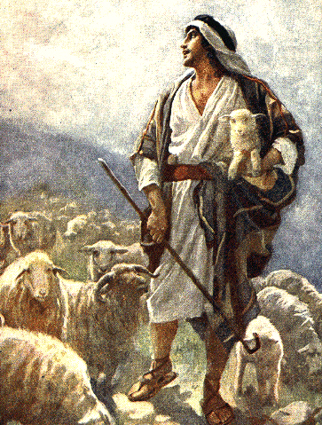
Acts 20:28-29
28 Therefore take heed to yourselves and to all the flock, among which the Holy Spirit has made you overseers, to shepherd the church of God which he purchased with His own blood
CHURCH ORGANIZATION

Slide 21
1 Peter 5:2-4
2 Shepherd the flock of God which is among you, serving as overseers, not by compulsion but willingly, not for dishonest gain but eagerly;
3 nor as being lords over those entrusted to you, but being examples to the flock
CHURCH ORGANIZATION

Slide 22
1 Cor. 13:8-13
8 Love never fails. But whether there are prophecies, they will fail, whether there are tongues, they will cease; whether there is knowledge, it will vanish away. 9 For we know in part and we prophesy in part. 10 But when that which is perfect has come, then that which is in part will be done away. 11 When I was a child, I
spoke as a child, I understood as a child, I thought as a child; but when I became a man, I put away childish things. 12 For now we see in a mirror dimly, but then face to face. Now I know in part, but then I shall know just as I also am known. 13 And now abide faith, hope, love, these three; but the greatest of these is love.
REVELATION

Slide 23
What is That Which is
  Definition of Perfect: Teleios NT:5046, “complete, perfect,” from telos, “an end,” is translated, “of full age” in Heb. 5:14, KJV (RV, “full grown man”) Vine’s Expository Dictionary
  It is not Christ in this context:
    He had already come
    When He returns it will be the judgment
  Part and Perfect (complete):
    Are in tandem
    Must be the same entity
    The common they share is the revelation of word of God
  Two illustrations:
    Growing up
    A mirror
  LESSON: Inspired man until the inspired written plan
PERFECT?

Slide 24
Prophecy & Establishment of the
OT Prophesy
Isaiah 2:2-3 Latter days Lord’s house established Law from Jerusalem
Daniel 2:44 Days-These Kings Everlasting Kingdom
Joel 2:28-32 Pour Out Spirit Jerusalem Whoever call - saved
Isaiah 62:2 New Name
Jer. 31:31-32 New Covenant
Gospels
Jo.3:1f; Mt.3:1f John the baptizer Crying in wilderness Prepares way for Jesus Repent Kingdom at hand
Matt. 4:17 Jesus identified Repent Kingdom at hand
Matt. 16:18-19 I will build My church Church and kingdom are the same
Mark 9:1 Kingdom coming with power in that generation
Mk15:16-20; 16:1f Jesus is crucified Jesus is risen on the 3rd day
Pentecost
Acts 1:3 Jesus speaks about Kingdom
Acts 1:4-8 Apostles Stay in Jerusalem Receive power when HS comes
Acts 2:1-4 Day of Pentecost Jerusalem Apostles Receive HSpirit
Acts 2:16 Peter preaches “This is that” What Joel spoke
Acts 2:36-47 Salvation Repent & Baptized Lord added the saved to His one church
After Pent
Acts 8:1 Church
Col. 1:13-14 Kingdom
Acts 11:26 Called Christians
Heb. 8:6-8 Established New Covenant
Acts 11:15 At Beginning
Rom. 16:16 Churches of Christ
Acts 14:23 Elders
Acts 20:28f; 1 Pet. 5:2f Autonomy “Among you”
1 Cor. 13:8f Inspired man til inspired plan
CHURCH

Slide 25
APOSTASY
First Century
Christians Only Acts 11:26
Only One Church Eph. 4:4; 1:20
Churches of Christ Rom. 16:16
Elders Acts 14:23 1 Pet. 5:2-4
Inspired Man 1 Cor. 13:8-13
Inspired Plan 1 Cor. 13:8-13
Apostasy Foretold Acts 20:28-30
ca.100-300AD
Nero Ignatius
Domitian Polycarp
Diocletian
Constantine Edict of Toleration
Nicean Council
After 300AD
Holy Water
Penance
Extreme Unction
Purgatory
Instrumental Music
Transubstantiation
Indulgences
Auricular Confession
Sprinkling for Baptism
CHURCH
APOSTASY BEGINS

Slide 26
Apostasy in Leadership
Plurality of Equal Elders Overseeing 1 Local Church
Elected Presiding Elders Over Each Local Church
E E E
E E E
Then This
PE E E
PE E E
E E E
E E E
Then This
PE E E
PE E E
Elected Country Bishops
PE PE PE PE PE PE PE
PE PE PE PE PE PE PE
Co.B
Nicean Council 325 A.D.
Elected City Bishops
CONSTANTINE PRESIDES
Co.B. PE Cy.B. PE Co. B. PE
Cy.B. PE Co.B. PE Cy. B. PE
Co.B. PE Co.B. PE Co. B.
Co.B. PE Co.B. PE Co. B.
Cy.B

Slide 27
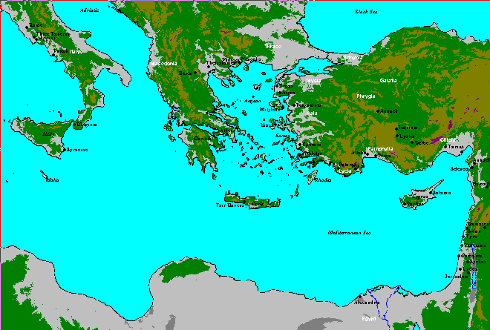
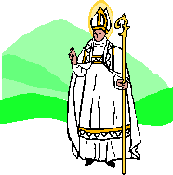
Evolution of Papacy
Presiding Bishops (Papas) vie for Supremacy
  Rome
  Constantinople
  Antioch
  Jerusalem
  Alexandria

Slide 28
Evolution of Denominations
    1054 Catholicism/Greek Orthodox
    1530 Lutheran Church Martin Luther
    1534 Church of England Henry VIII
    1536 Presbyterian John Calvin
    1607 Baptist John Smyth
    1655 Quaker
    1729 Methodist John Wesley
    1830 Mormon Joseph Smith
    1844 7th Day Adventist
    1878 Christian Science
    1884 Jehovah’s Witness
    1899 Pentecostal
Over 1300
Denominations
Exist Today!

Slide 29
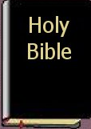

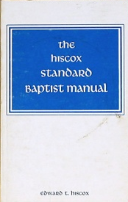
Seed Produces After Its Kind
God’s Word
Christian
God’s Word
Catholic
Catechism
+
Catholic – “Christian”
God’s Word
Baptist Manual
+
Baptist - “Christian”

Slide 30
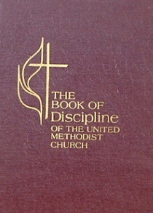
Seed Produces After Its Kind
God’s Word
Methodist
Discipline
+
Methodist – “Christian”
God’s Word
Creed
Book
+
Hyphenated - “Christian”
God’s Word Only
Christian Only

Slide 31
What Does the Word of God Say?
Examples | Believe | Repent | Confess | Baptized
Pentecost Acts 2:1-47
Samaritans Acts 8:4-12
Eunuch Acts 8:26-39
Saul Acts 9:1-9; 22:16
Cornelius Acts 10-11
Lydia Acts 16:11-15
Phil. Jailer Acts 16:25-34
Corinth Acts 18:8
X
X
X
X
X
X
X
X
X
(X)
X
X
X
X
X
Why All The Blank Spaces?

Slide 32
What Does the Word of God Say?
Examples | Believe | Repent | Confess | Baptized
Pentecost Acts 2:1-47 | R |  | R
Samaritans Acts 8:4-12 |  | R | R
Eunuch Acts 8:26-39 | R | R
Saul Acts 9:1-9; 22:16 | R | R | R
Cornelius Acts 10-11 |  | R | R
Lydia Acts 16:11-15 |  | R | R
Phil. Jailer Acts 16:25-34 |  | R | R
Corinth Acts 18:8 |  | R | R
 | Heb. 11:6 | Luke 13:3-5 | Rom. 10:9-10 | Gal. 3:27
X
X
X
X
X
X
X
X
X
X
X
X
X
X
X

Slide 33
What the Word of God Says!
To become a Christian one must:
  Believe in Jesus as the son of God
  Repent of sins
  Confess belief in Christ as the son of God (Not that one has sinned, been saved or had an experience)
  Be immersed in the water in order to obtain remission of sins
SALVATION

Slide 34
Why Baptism?
Is there a contradiction with the command for baptism and salvation by the blood in John 19:34?
Baptism
Remission of Sins Acts 2:38
Good Conscience 1 Pet. 3:21
Wash Away Sin Acts 22:16
Versus
Blood
Forgiveness Eph. 1:7
Redemption Col. 1:14
Made White Rev. 7:14
CONTRADICTION?

Slide 35
How Would You Be
DIED
ALIVE
CHRIST
BURIED?
Rom. 6:3-4
BURIED

Slide 36
How Would You Be
YOU
DEAD
IN SIN
ALIVE
(new creature)
BURIED?
Rom. 6:3-4
Col. 2:12
Buried in
Baptism

Slide 37
How Would You Be
Denominational View
John 10:2; Matt. 15:9
DEAD
IN SIN
“Passed from death unto life”
ALIVE
(new creature)
BURIED?
Voted on
( No scripture)
Buried in
Baptism
Buried alive

Slide 38
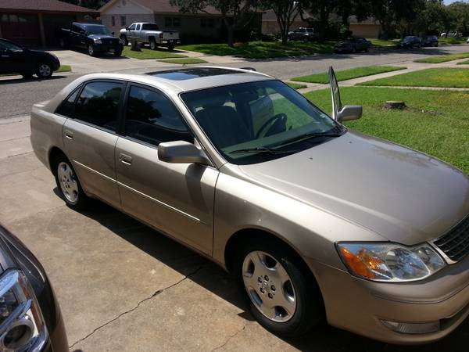
Finding My
My Car
CAR
Another Car
Older-2004 Avalon
Beige
Beige leather interior
Sunroof
Tag #198-768 Ky
New
Bright Red
Black Interior
Convertible
Tag# 87-9855 NY

Slide 39
Finding Christ's
A Church
Another Church
Church of Christ
Christians
Believe,Repent, Confess & Baptized
Elders and Deacons
Lord’s Supper Every Lord’s Day
Free Will Giving Each Lord’s Day
Baptist Church
Baptists
Voted on, “Buried Alive”
No Elders
Pastor (Bishop)
Communion When Convenient
Rummage Sales, Tithe
CHURCH

Slide 40
Where Are You?
Cleansing
Telling
Turning
Convicting
BELIEVE
REPENT
CONFESS
BAPTISM
SALVATION
John 8:24
Luke 13:3
Rm.10:9-10
Mark 16:16

